Slide 1
Inventergy Innovations, LLC
Innovation to transform emergent technologies and companies by leveraging the combination of technology and patent strategy to drive optimum value
Joe Beyers
Chairman
Joe@inventergy.com
Ken Cannizzaro
CEO
Ken@inventergy.com

Slide 2
Differentiated Value Creation Execution Model
The companies that we create, acquire or enable have as their core objective to be successful long term operating companies. However, their implementation models, with our guidance, are constructed to effectively enable alternative models in order to maximize a timely return on investment through:
Joint ventures with operating companies
Acquisitions:
By operating companies
By financial institutions
Technology development and licensing
Patent licensing
Business Strategy
Technology
Patents
Leveraging technology and
patent strategy
Value Creation
Notes:
The Proof of Concept sciences – validated sciences in a combination that needs validation

Slide 3
Differentiated Value Creation Execution Model
Technology licensing
Strategic partnering
Technology divestitures
Technology acquisitions
Technology
Patents
Patent licensing
Patent sales
Patent acquisitions
Patent enforcement
Leveraging technology and
patent strategy
Leveraging the combination of technology and patent strategy drives optimum enterprise value.
Notes:
The Proof of Concept sciences – validated sciences in a combination that needs validation

Slide 4
Wide Range of Approaches to Value Creation
Inventergy Innovation creates value through Innovation and Invention in number of dimensions
Technology development strategy
Intellectual property strategy
Innovative business models
Execution/exit strategies
Investment structures
Management processes
Partnership strategies

Slide 5
Inventergy Innovation, LLC is NOT:
An incubation center
A law firm
A venture capital firm
An IP company
A management/business consulting company
An innovation think tank
It is ALL of the above to provide cohesive forward looking strategies that connect to market opportunities.
Notes:
The Proof of Concept sciences – validated sciences in a combination that needs validation

Slide 6
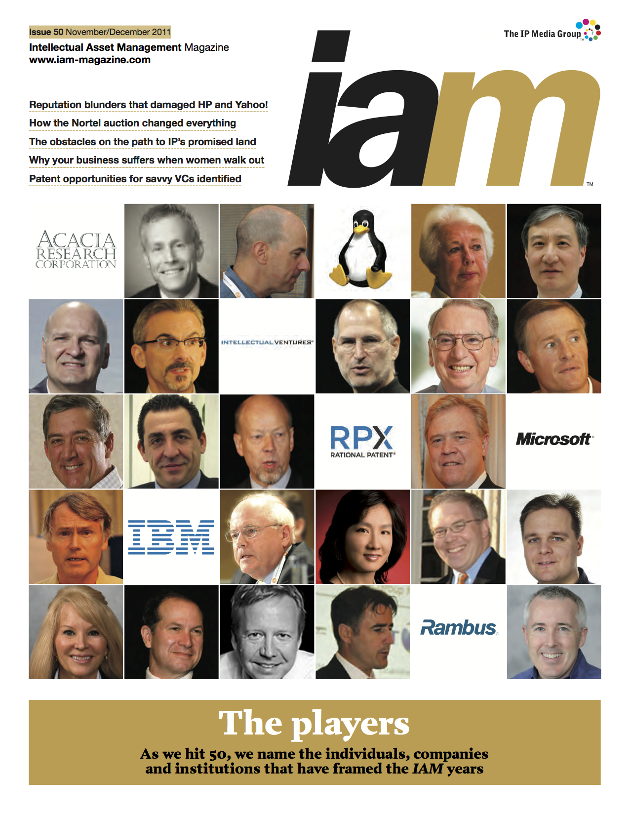
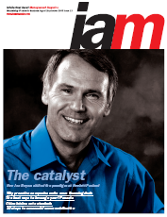
Joe Beyers - IAM Magazine covers - one of the premier IP magazines
Intellectual Asset Magazine
6
Notes:
6

Slide 7
Inventergy Innovations, LLC
Joe Beyers – Chairman
Technologist
Patents on desktop computing
Inventor of the world's 1st 32-bit computer chip
Business Manager & Entrepreneur
Started 7 Software businesses in HP
Former head of HP’s Internet business unit – $600M/yr. revenue
M&A and business planning – 7 years
Led equity investments, acquisitions and divestitures
Intellectual Property – 6 years
Patent, standards, technology & brand licensing for all of HP
Grew IP income 10X
Company creation/start-up experience
Founder & board member of Allied Security Trust (AST) – 14 member companies
VP at Taligent – Joint Venture of Apple, HP & IBM
Spun out technology from HP and started 8 companies in his last 4 years Medical Devices, IC Technology and Solar Technology
Founding Chairman and former CEO of Ambature, LLC
Co-Founder and Chairman of Silicon Turbine Systems, Inc.
Founder, Chairman and CEO of Inventergy Global, Inc
Intellectual Asset Magazine
Notes:
7

Slide 8
Inventergy Innovations, LLC
Ken Cannizzaro – CEO
Technologist
Industry’s first real time Unix operating system
Industry’s first Unix Notebook computer
Business Manager & Entrepreneur
Business executive and intellectual property professional
Founding member multiple - software /hardware /service companies
Former Managing Director of HP’s Intellectual Property
M&A and business planning – 10 years
Led equity investments
Technology & IP transfers, acquisitions and divestitures
Intellectual Property – 15 years
Intellectual property strategies, patent, standards, technology & brand licensing for industry leading multinational firms to venture-financed startups
Intellectual property experience in creation of hundreds of millions of dollars in transactional experience.
Company creation/start-up experience
Founding member of Massachusetts Computer Inc.
Founding member of Tadpole Technology
Founded Technology Services
CEO of e*star
Co-founded Danzante Destination Eco-Resort (Baja Mexico)
Founding member of IPVALUE Management
8
Notes:
8

Slide 9
Do You Have Need For The Following
Business Strategy
Intellectual Property Strategy
Law Firm
Mentorship
Strategic partnerships
Access to Growth Capital
If you checked one or more boxes– we can help
Led by IP industry veterans Joe Beyers and Ken Cannizzaro, the Company utilizes decades of corporate, market, technology and Intellectual Property expertise, as well as industry connections to assist innovators and emergent technology companies in leveraging the value of their innovations to achieve maximum returns.
Notes:
The Proof of Concept sciences – validated sciences in a combination that needs validation

Slide 10
Contact Information
Joe Beyers Chairman
Office: 408.389.3547
joe@inventergy.com
Ken Cannizzaro
CEO
Office: 408 234 1225
Ken@Inventergy.com

