Slide 1
SeaMicro
Use Cases Review
with
Space, Power, and Network Savings Analysis
Prepared for YAHOO!

Slide 2
Exec Summary
SeaMicro’s offers 384 dual core servers in 10 Rack Units operating at 10 W per server. Depending use case this configuration can replace as many as 384 servers, or as few as 25 servers.
In a 40 U Rack with 10 kW SeaMicro can fit 1024 servers or 2048 cores.
In a 40U Rack with 15 kW SeaMicro can fit 1536 servers or 3072 cores.
Dramatic savings come in the form of:
Less Data Center space / racks consumed for the same compute power
Less power consumed [kW and MW] for the same compute power
Less Switch ports consumed for the same compute power
Actual savings vary by application as many applications do not match the generic Spec workload
Yahoo’s largest expense is cost of data center construction – though advances have been made with the YCC design, the cheapest data center is still the one you don’t have to build. SeaMicro helps fit more compute in existing data centers.

Slide 3
About SeaMicro
Founded in July 2007
Based in Sunnyvale, CA
$60 Million from leading venture capitalists and strategic partners
Khosla Ventures
Draper Fisher Jurvetson
Crosslink Capital
Leading strategic investors
$9.3 Million DOE grant for Energy Efficient Information and Communication Technologies
The largest given to a server company
Second only to the $9.9 million given to Yahoo!
More than IBM, HP, Dell, Cisco, Alcatel

Slide 4
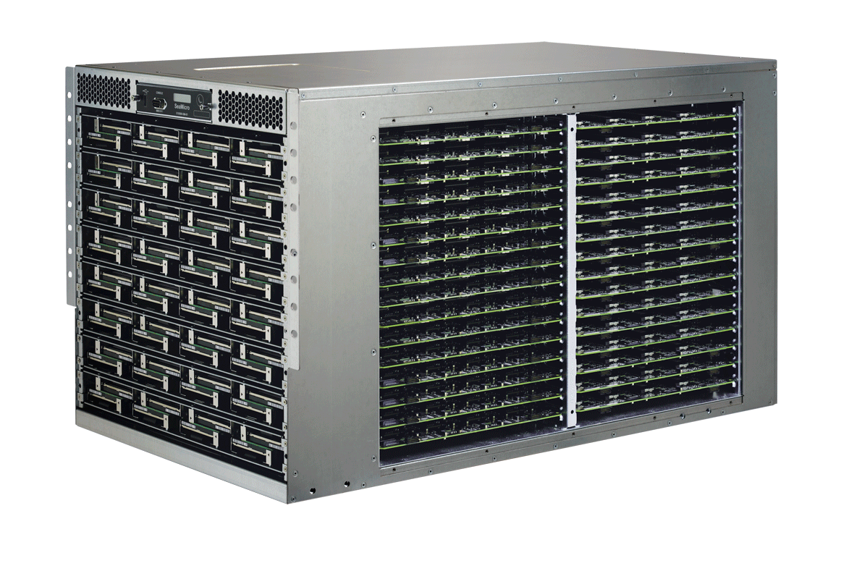
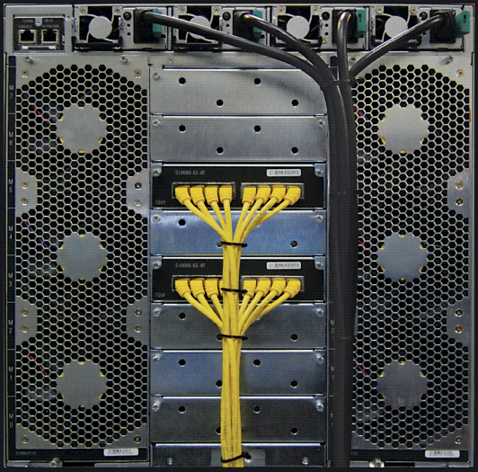
The SM10000-64HD: 768 Atom Cores An entire rack of functionality in 10 RU
384 Dual Core Sockets
768 x 1.6Ghz Intel x86 64 bit Cores
1.5 Terabyte DRAM (4GB per Socket)
0 - 64 SATA SSD/Hard Disks
1.28 Terabit fabric interconnect
Up to 64 x 1GbE and/or 16 x 10 GbE uplinks
“Fail in place” architecture
Hot swappable, fans, disk, power supplies, compute, Ethernet, and storage cards
Runs off the shelf OS and applications
Power Consumption:
3.5 KW under typical workloads

Slide 5
SeaMicro Performance Summary
SM10000-64HD replaces anywhere from 25 to 384 Dual Socket Quad Core CPUs
Use Case | SeaMicro SM10000-64HD | Number of 1RU servers replaced
Config 0 | 1 | 384
Image CDN | 1 | 67
Instant Messaging | 1 | 58
Message Processing | 1 | 54
Hadoop | 1 | 53
Apache Traffic Server | 1 | 36
SpecInt_rate2000* | 1 | 25
* Estimate Based on PEG testing performed by John Glover

Slide 6
Config 0 – Savings 1 SM10000-64HD = 384 Config 0 Servers
Space savings – 374 Rack Units
SeaMicro = 10 Rack Units
Config 0 = 384 servers – 1 U each
Network Savings – 368 GigE ports
SeaMicro = 16 GigE ports with LAG provides redundancy and aggregate bandwidth
Config 0 = 384 Servers ~ 384 GigE ports to Top of rack Switches
Power Savings ~ 69 kW
SeaMicro ~ 3.8 kW
Config 0 384 Servers x 190W ~ 73 kW
Many applications tend to be not CPU bound, but limited by application, IO, or demand / requests – For these applications – like Config 0 a SeaMicro node can deliver a one to one ratio compared to Xeon based 1U servers.
SeaMicro supports RHEL 4u8 as well as other flavors which may not be supported by current generation HW from other manufacturers

Slide 7
Image CDN - Savings 1 SM10000-HD = 67 Dual Socket Quad [L5630] Servers
Space savings – 57 Rack Units
SeaMicro = 10 Rack Units
HP DL 360 = 67 servers – 1 U each
Network Savings – 57 GigE ports
SeaMicro = 10 GigE ports with LAG provides redundancy and aggregate bandwidth
HP DL 360 = 67 Servers ~ 67 GigE ports to Top of rack Switches
Power Savings ~ 11 290 W
SeaMicro ~ 3800 W
HP DL 360 - 67 Servers x 225W ~ 15 090 W

Slide 8
Instant Messaging - Savings 1 SM10000-64HD = 58 Dual Socket Quad [L5630] Servers
Space Savings – 48 Rack Units
SeaMicro = 10 Rack Units
1U Servers = 58 servers – 1 U each
Network Savings – 46 GigE ports
SeaMicro = 12 GigE ports with LAG provides redundancy and aggregate bandwidth
1U = 58 Servers ~ 58 GigE ports to Top of rack Switches
Power Savings ~ 10700 W
SeaMicro ~ 3800 W
1U Xeon server 58 Servers x 250W ~ 14500 W

Slide 9
Message processing - Savings 1 SM10000-64HD = 55 Dual Socket Quad Core [E5620] Servers
Space savings – 45 Rack Units
SeaMicro = 10 Rack Units
Scribe Tier = 55 servers – 1 U each
Network Savings – 46 GigE ports
SeaMicro = 8 GigE ports with LAG provides redundancy and aggregate bandwidth
Scribe Tier = 54 Servers ~ 54GigE ports to Top of rack Switches
Power Savings ~ 5650 W
SeaMicro ~ 3800 W
Scribe Tier Servers x 174 W = 9450 W
One SeaMicro chassis with 384 servers can replace 54 systems by achieving the same level of message processing from Apache server via Scribe.

Slide 10
Hadoop* - Savings 1 SM10000-64 = 38 Dual Socket Quad [L5630] Servers
Space savings – 28 Rack Units
SeaMicro 10 Rack Units
38 x 1 RU servers = 38 Rack Units
Network Savings – 34 GigE ports
SeaMicro – 4 GigE ports with LAG provides redundancy and aggregate bandwidth
[SeaMicro nodes interconnect via high bandwidth low latency internal fabric]
1 RU – 38 Servers ~ 38 GigE ports to Top of rack Switches
Power Savings ~ 7000 W
SeaMicro ~ 2500 W
1 RU 38 Servers x 250W ~ 9500 W
* Hadoop test performed on 256 server SeaMicro chassis.

Slide 11
Apache Traffic Server (ATS) - Savings 1 SM10000-64HD = 45 Dual Socket Quad Core Servers
Space savings – 35 Rack Units
SeaMicro 10 Rack Units
45 x 1 RU servers
Network Savings – 39 GigE ports
SeaMicro – 6 GigE ports with LAG provides redundancy and aggregate bandwidth
1 RU – 45 Servers ~ 45 GigE ports to Top of rack Switches
Power Savings ~ 5200 W
SeaMicro ~ 3800 W
1 RU 45 Servers x 200W ~ 9000 W

Slide 12
Yahoo! Server Refresh 710 SM10000-64HD = 25000 Dual Socket Quad Core Servers
Yahoo is constantly refreshing servers
Assume 25 000 servers of different configurations and different age.
In an effort to minimize capital expense older servers are often recycled into new use cases
What is the OpEx cost of recycling this hardware ?
We examined the cost of operating these servers compared to the Savings that Yahoo can find by refreshing them with SeaMicro
We found that Deploying SeaMicro would save a small data center worth of resources
2 MW, 450 Racks and 20 000 Switch ports

Slide 13
Re-Deploying Yahoo Systems True cost of recycling 25000 systems
Compute : 25000 servers x 18 spec per server = 450,000 Spec
Space 25000 Servers / 40 servers per Rack = 625 Racks
Power 25000 servers x 190 Watts per server = 4750 kW
Network 25000 servers x 1 GigE port = 25000 GigE ports
Equivalent SeaMicro compute given 1.65 Spec per socket would be
450,000 Spec / 1.65 Spec per Socket * 384 sockets per SeaMicro= 710 SeaMicro
Space 710 Chassis / 4 Chassis per Rack = 177 Racks
Power 710 Chassis x 3.8 kW / Chassis = 2698 kW
Network 710 Chassis x 8 GigE ports = 5680 GigE ports
SeaMicro Savings = One Small Data Center
Space 625 - 177 = 448 Racks
Power 4750 kW - 2698 kW = 2052 kW [2 MW]
Network 25000 - 5680 = 19 320 GigE ports

Slide 14
Supporting Material
Additional details on savings calculations and test scenarios

Slide 15
Application Use Case
Config 0
RHEL 4u8 replacement

Slide 16
Config 0 – Savings 1 SM10000-64HD = 384 Config 0 Servers
Space savings – 374 Rack Units
SeaMicro = 10 Rack Units
Config 0 = 384 servers – 1 U each
Network Savings – 368 GigE ports
SeaMicro = 16 GigE ports with LAG provides redundancy and aggregate bandwidth
Config 0 = 384 Servers ~ 384 GigE ports to Top of rack Switches
Power Savings ~ 69000 kW
SeaMicro ~ 3800 W
Config 0 384 Servers x 190W ~ 73000 kW
Many applications tend to be not CPU bound, but limited by application, IO, or demand / requests – For these applications – like Config 0 a SeaMicro node can deliver a one to one ratio compared to Xeon based 1U servers.
SeaMicro supports RHEL 4u8 as well as other flavors which may not be supported by current generation HW from other manufacturers

Slide 17
Application Use Case
Image CDN

Slide 18
Image CDN - Savings 1 SM10000-HD = 67 Dual Socket Quad [L5630] Servers
Space savings – 57 Rack Units
SeaMicro = 10 Rack Units
HP DL 360 = 67 servers – 1 U each
Network Savings – 57 GigE ports
SeaMicro = 10 GigE ports with LAG provides redundancy and aggregate bandwidth
HP DL 360 = 67 Servers ~ 67 GigE ports to Top of rack Switches
Power Savings ~ 11 290 W
SeaMicro ~ 3800 W
HP DL 360 - 67 Servers x 225W ~ 15 090 W

Slide 19
Case Study – Image CDN
Apache Static Data serving
Application and infrastructure
Customer will open 30-50 new POPs internationally to serve image content
Data centers are leased co-location facilities worldwide
Power and space costs are anywhere from 2x-4x more expensive than in the United States
Images fit and are served from local DRAM
Average object size is 16KB

Slide 20
Image CDN – Apache Static Data Serving
Before and After with SeaMicro Architecture
Current Architecture
SeaMicro Architecture
Router
Router
Router
Router
10 GbE
10 GbE
Inline FDRY LB
Cisco 4948
Cisco 4948
Inline FDRY LB
10 GbE
10 GbE
N x 1 GbE
10 GbE
1 GbE
1 GbE
Seamicro Appliance
1U Server
1U Server
10 – 20 servers
10 – 20 servers
Operational challenges
Complexity is high for a lights out environment
Power and space costs are prohibitive
Capital intensive
Load-balancers and switching are expensive for the functionality
SeaMicro architecture
Uses 1/4th the space and power of the current architecture
Load balancing and switching layers are eliminated
Deployment is accelerated and simplified
Enable non-skilled labor to deploy

Slide 21
SM10000-64 versus HP DL360 G7 Apache Test Methodology
Compare
performance/watt
performance/rack unit
Configured
CPUs with CentOS 5.4
Apache 2.2 with Apache Bench
Model web workload as 16 KB file
Retrieve file with Apache bench for 10 minutes
Measure power
XiTRON 2801 power meter
Aggregated with LabView v7.1

Slide 22
SM10000-64 versus HP DL360 G7 Apache Performance Results
 | SeaMicro | HP
System Configuration | SM10000-64 384 x Dual Core 1.66GHz Atom processors | HP DL360 G7 Dual Socket Quad Core Xeon L5630 2.13GHz
Systems Under Test | 1 | 67
Apache Throughput/Sec | 1,507,584 | 1,507,680
Apache Request File Size | 16KB | 16KB
System Power | 3,780W | 15,090W
Space consumed in Racks | 10 RU | 67 RU

Slide 23
Application Use Case
Instant Messaging

Slide 24
Instant Messaging - Savings 1 SM10000-64HD = 58 Dual Socket Quad [L5630] Servers
Space Savings – 48 Rack Units
SeaMicro = 10 Rack Units
1U Servers = 58 servers – 1 U each
Network Savings – 46 GigE ports
SeaMicro = 12 GigE ports with LAG provides redundancy and aggregate bandwidth
1U = 58 Servers ~ 58 GigE ports to Top of rack Switches
Power Savings ~ 10700 W
SeaMicro ~ 3800 W
1U Xeon server 58 Servers x 250W ~ 14500 W

Slide 25
Case Study – Instant Messaging
Application
Integrated Instant Messaging
SeaMicro’s customer provides integrated instant messaging service. End users can use this customer’s IM client and to communicate with users on different IM provider’s networks
Example:
With the integrated client, a Yahoo IM user can talk with an AOL IM uses

Slide 26
Previous Architecture
Instant Messaging
To ISP
Router
Router
IDP Device
IDP Device
G
H
Inline LB
L3 Switch
L3 Switch
Inline LB
C
D
E
F
Rack Switch
Rack Switch
A
B
Dell/Other 1U
Dell/Other 1U
1RU Servers
Each 1RU server is configured with Dual Socket, Quad Core L5630 with 16GB DRAM and 1 SATA HDD.
Inline LB operates in Layer 4 load-balancing mode
Rack-switches provide 1GbE to each server with 2 x 1GbE uplink to the L3 switch

Slide 27
Architecture w/SeaMicro
Instant Messaging
To ISP
Router
Router
Dramatic reduction in power and space
Simplified Architecture
Eliminate Rack Switch and Load Balancer
Links A, B, G, H are all LAGs
Seamicro Appliance connects directly to L3 switch Interfaces
IDP Device
IDP Device
G
H
L3 Switch
L3 Switch
A
B
SeaMicro SM10000

Slide 28
Competitive Comparison SeaMicro vs. Ironsystems
Application
Compare the number of user sessions that can be supported per rack with SeaMicro and Intel Westmere
Comparison Systems
N x Ironsystems1RU
Dual Socket Quad Core L5630 w/12GB DDR3
8 Core each 2.13GHz
2 x 500 GB SATA Disk
Redundant Power – 250W consumption
2 Rack Switches and 1 Terminal Server is used for each 32 servers
N x SeaMicro SM10000
512 1.6GHz Intel Atom CPUs
1TB DDR2 Memory
16 x 320 GB SATA Disk
2,500W

Slide 29
Competitive Results Instant Messaging
 | SeaMicro 384 Nodes | Ironsystems L5630
User connections per second per system | 460,800 | 8,000
Rack Units | 10 RU | 1 RU
Power per system | 3840 W | 250 W
Systems | 1 | 58
Total Power | 3840 W | 14500 W
Total user connections | 307200 | 464000

Slide 30
Application Use Case
Message Processing / Scribe

Slide 31
Message processing - Savings 1 SM10000-64HD = 55 Dual Socket Quad Core [E5620] Servers
Space savings – 45 Rack Units
SeaMicro = 10 Rack Units
Scribe Tier = 55 servers – 1 U each
Network Savings – 46 GigE ports
SeaMicro = 8 GigE ports with LAG provides redundancy and aggregate bandwidth
Scribe Tier = 54 Servers ~ 54GigE ports to Top of rack Switches
Power Savings ~ 5650 W
SeaMicro ~ 3800 W
Scribe Tier Servers x 174 W = 9450 W
One SeaMicro chassis with 384 servers can replace 54 systems by achieving the same level of message processing from Apache server via Scribe.

Slide 32
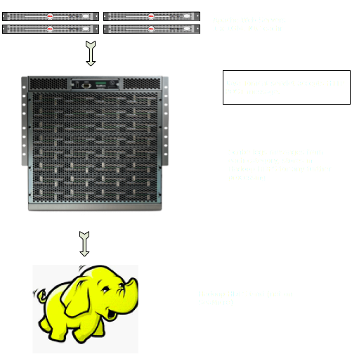
Case Study – Message processing Using Scribe
Log messages created from Web heads flow to the SeaMicro running Tomcat/Scribe which aggregates and forwards to Hadoop Grid for analysis
Application infrastructure:
Web Tier consisting of 1RU Apache App servers
Scribe tier consisting of 1RU servers running TomCat and Scribe
Hadoop Grid

Slide 33
SM10000-64 versus E5620 Scribe Results
 | SeaMicro | Dell
System Configuration | SM10000-64 384 x Dual Core 1.66GHz Atom processors | Dual Socket Quad Core Xeon E5620 2.13GHz
Systems Under Test | 1 | 54
Scribe Messages/Sec | 3,794,285 | 3,820,833
Message Size | 1KB | 1KB
System Power | 3,780 W | 9450 W
Space consumed in Racks | 10 RU | 54 RU

Slide 34
Application Use Case
Hadoop

Slide 35
Hadoop* - Savings 1 SM10000-64 = 38 Dual Socket Quad [L5630] Servers
Space savings – 28 Rack Units
SeaMicro 10 Rack Units
38 x 1 RU servers = 38 Rack Units
Network Savings – 34 GigE ports
SeaMicro – 4 GigE ports with LAG provides redundancy and aggregate bandwidth
[SeaMicro nodes interconnect via high bandwidth low latency internal fabric]
1 RU – 38 Servers ~ 38 GigE ports to Top of rack Switches
Power Savings ~ 7000 W
SeaMicro ~ 2500 W
1 RU 38 Servers x 250W ~ 9500 W
* Hadoop test performed on 256 server SeaMicro chassis.

Slide 36
Case Study - Hadoop
Application
Run Map Reduce on 50GB compressed data
Total Intermediate file size needed is 10TB
Comparison Systems
N x Dell 1RU
Dual Socket Quad Core L5630 w/24GB DDR3
8 Core each 2.13GHz
2 x 500 GB SATA Disk
Redundant Power – 250W consumption
2 Rack Switches and 1 Terminal Server is used for each 32 servers
N x SeaMicro SM10000
512 1.6GHz Intel Atom CPUs
1TB DDR2 Memory
32 x 500 GB SATA Disk
2,500W

Slide 37
Performance Comparison
SeaMicro vs. Dell
System Count
System Count
Dell System Count | Dell MR Time (mins) | Dell Power (KW)
16 | 29.5 | 4.20
32 | 20.20 | 8.40
64 | 12.20 | 16.80
128 | 7.1 | 33.60
SeaMicro System Count | SeaMicro MR Time (mins) | SeaMicro Power (KW)
0.5 | 25.5 | 1.25
1 | 17.3 | 2.50
2 | 10.4 | 5.00
4 | 6.2 | 10.00

Slide 38
Normalized Comparison
SeaMicro Consumes 3.9x Less Power & 4.5x Less Space
Power Consumed (KW)
Normalized MapReduce Time (minutes)
Sort Time (mins) | Number of SeaMicro Systems | Normalized Number of Dell Systems | SeaMicro Power (KW) | Dell Power (KW)
25.5 | 0.5 | 18.51 | 1.25 | 4.97
17.3 | 1 | 37.36 | 2.50 | 10.04
10.4 | 2 | 75.08 | 5.00 | 20.18
6.2 | 4 | 146.58 | 10.00 | 39.39

Slide 39
SeaMicro vs. Dell R410 Hadoop Performance Results
 | SeaMicro | Dell
System Description | SM10000-64 256 x dual core 1.66 GHz 64 SATA HDD | Dell R410 Dual socket quad core L5630, 2.13GHz, 4 SATA HDD
System Count | 1 | 35
Data sorted | 500GB | 500GB
Time | 30 minutes | 30 minutes
Rack Units | 10 | 35
Power consumed= energy consumed for test duration | 1.24 KWH | 4.1 KWH

Slide 40
Application Use Case
Apache Traffic Server

Slide 41
Apache Traffic Server (ATS) - Savings 1 SM10000-64HD = 45 Dual Socket Quad Core Servers
Space savings – 35 Rack Units
SeaMicro 10 Rack Units
45 x 1 RU servers
Network Savings – 39 GigE ports
SeaMicro – 6 GigE ports with LAG provides redundancy and aggregate bandwidth
1 RU – 45 Servers ~ 45 GigE ports to Top of rack Switches
Power Savings ~ 5200 W
SeaMicro ~ 3800 W
1 RU 45 Servers x 200W ~ 9000 W

Slide 42
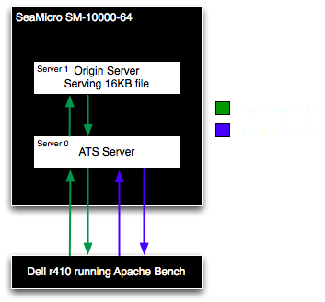
Case Study - Apache Traffic Server
ATS is a powerful proxy that can use regular expressions to parse and remap URL’s, along with analyzing and distributing load based on HTTP headers.
Hardware Setup:
2 x SeaMicro Servers (Intel N570 dual-core Atoms each with 4GB RAM)
1 X Dell Intel L5620 (dual socket, Quad core with 8GB RAM)
Software Stack:
CentOS 5.5
ATS 2.1.6
PHP 5.3.6
Apache Bench 2.2.3

Slide 43
Apache Traffic Server ATS Testing
Configured one SeaMicro Server with ATS
Configured one SeaMicro Server as Origin server
The ATS Server was set to cache results from Origin Server
Used Dell to generate load
Result: 5700 RPS with 100% cache-hit

Slide 44
SeaMicro vs. Dell R410 ATS Performance Results
 | SeaMicro | Dell
System Description | SM10000-64 256 x dual core 1.66 GHz 64 SATA HDD | Dell R410 Dual socket quad core L5630, 2.13GHz, 4 SATA HDD
System Count | 1 | 32
Requests Per Second / Node | 5700 | 70,000*
Requests Per Second / Cluster | 2,188,800 | 2,240,000
System Power used | 3,780 W | 6,650 W
Rack Units | 10 | 32
* Based on ATS 2.0 100% cache hit

