Slide 1
Inventergy Innovations, LLC
Innovation to transform emergent technologies and companies by leveraging the combination of technology and patent strategy to drive optimum value
Joe Beyers
Chairman
Joe@inventergy.com
Ken Cannizzaro
CEO
Ken@inventergy.com

Slide 2
Differentiated Value Creation Execution Model
The companies that we create, acquire or enable have as their core objective to be successful long term operating companies. However, their implementation models, with our guidance, are constructed to effectively enable alternative models in order to maximize a timely return on investment through:
  Joint ventures with operating companies
  Acquisitions:
      By operating companies
      By financial institutions
  Technology development and licensing
  Patent licensing
Business Strategy
Technology
Patents
Leveraging technology and
patent strategy
Value Creation
Notes:
The Proof of Concept sciences – validated sciences in a combination that needs validation

Slide 3
Differentiated Value Creation Execution Model
Technology licensing
Strategic partnering
Technology divestitures
Technology acquisitions
Technology
Patents
Patent licensing
Patent sales
Patent acquisitions
Patent enforcement
Leveraging technology and
patent strategy
Leveraging the combination of technology and patent strategy drives optimum enterprise value.
Notes:
The Proof of Concept sciences – validated sciences in a combination that needs validation

Slide 4
Wide Range of Approaches to Value Creation
  Inventergy Innovation creates value through Innovation and Invention in number of dimensions
  Technology development strategy
  Intellectual property strategy
  Innovative business models
  Execution/exit strategies
  Investment structures
  Management processes
  Partnership strategies

Slide 5
Inventergy Innovation, LLC is NOT:
An incubation center
A law firm
A venture capital firm
An IP company
A management/business consulting company
An innovation think tank
It is ALL of the above to provide cohesive forward looking strategies that connect to market opportunities.
Notes:
The Proof of Concept sciences – validated sciences in a combination that needs validation

Slide 6
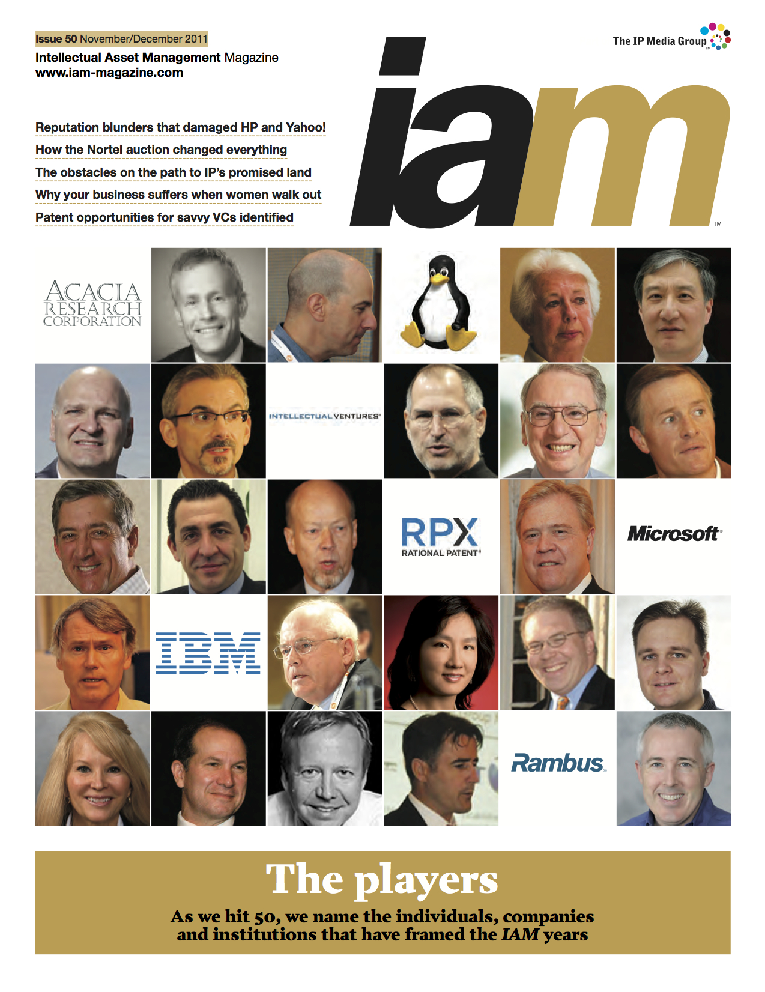
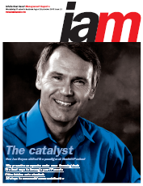
Joe Beyers - IAM Magazine covers - one of the premier IP magazines
Intellectual Asset Magazine
6
Notes:
6

Slide 7
Inventergy Innovations, LLC
Joe Beyers – Chairman
  Technologist
    Patents on desktop computing
    Inventor of the world's 1st 32-bit computer chip
  Business Manager & Entrepreneur
    Started 7 Software businesses in HP
    Former head of HP’s Internet business unit –
    $600M/yr. revenue
  M&A and business planning – 7 years
    Led equity investments, acquisitions and divestitures
  Intellectual Property – 6 years
    Patent, standards, technology & brand licensing for all of HP
    Grew IP income 10X
  Company creation/start-up experience
    Founder & board member of Allied Security Trust (AST) – 14 member companies
    VP at Taligent – Joint Venture of Apple, HP & IBM
    Spun out technology from HP and started 8 companies in his last 4 years Medical Devices, IC Technology and Solar Technology
    Founding Chairman and former CEO of Ambature, LLC
    Co-Founder and Chairman of Silicon Turbine Systems, Inc.
    Founder, Chairman and CEO of Inventergy Global, Inc
Intellectual Asset Magazine
Notes:
7

Slide 8

Inventergy Innovations, LLC
Ken Cannizzaro – CEO
  Technologist
    Industry’s first real time Unix operating system
    Industry’s first Unix Notebook computer
  Business Manager & Entrepreneur
    Business executive and intellectual property professional
    Founding member multiple - software /hardware /service companies
    Former Managing Director of HP’s Intellectual Property
  M&A and business planning – 10 years
    Led equity investments
    Technology & IP transfers, acquisitions and divestitures
  Intellectual Property – 15 years
    Intellectual property strategies, patent, standards, technology & brand licensing for industry leading multinational firms to venture-financed startups
    Intellectual property experience in creation of hundreds of millions of dollars in transactional experience.
  Company creation/start-up experience
    Founding member of Massachusetts Computer Inc.
    Founding member of Tadpole Technology
    Founded Technology Services
    CEO of e*star
    Co-founded Danzante Destination Eco-Resort (Baja Mexico)
    Founding member of IPVALUE Management
8
Notes:
8

Slide 9
Do You Have Need For The Following
  Business Strategy
  Intellectual Property Strategy
  Law Firm
  Mentorship
  Strategic partnerships
  Access to Growth Capital
  If you checked one or more boxes– we can help
  Led by IP industry veterans Joe Beyers and Ken Cannizzaro, the Company utilizes decades of corporate, market, technology and Intellectual Property expertise, as well as industry connections to assist innovators and emergent technology companies in leveraging the value of their innovations to achieve maximum returns.
Notes:
The Proof of Concept sciences – validated sciences in a combination that needs validation

Slide 10
Contact Information
Joe Beyers
Chairman
  Office: 408.389.3547
  joe@inventergy.com
Ken Cannizzaro
CEO
Office: 408 234 1225
Ken@Inventergy.com

