Slide 1
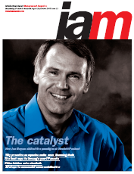
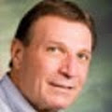
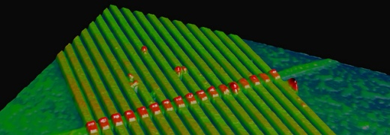
Inventergy Innovations, LLC
Intellectual Asset Magazine
Joe Beyers – Chairman
Ken Cannizzaro – CEO
Joe and Ken have completed hundreds of intellectual property transactions, technology transfers, asset sales and technology divestitures resulting in hundreds of millions of dollars in transactional revenues.
Some deal examples:
HP-Hynix and HP-AMD collaboration agreements for memory development - http://www.eetimes.com/electronics-news/4207222/HP--Hynix-move-to-commercialize-the-memristor-semiconductor and divestiture of HP’s Client Automation software business unit – “Persistent Systems Announces Licensing Agreement With Hewlett Packard for HP Client Automation (HPCA) Software” - http://finance.yahoo.com/news/persistent-systems-announces-licensing-agreement-141600161.html
A circuit with 17 memristors captured by an atomic force microscope
Notes:
1

Slide 2
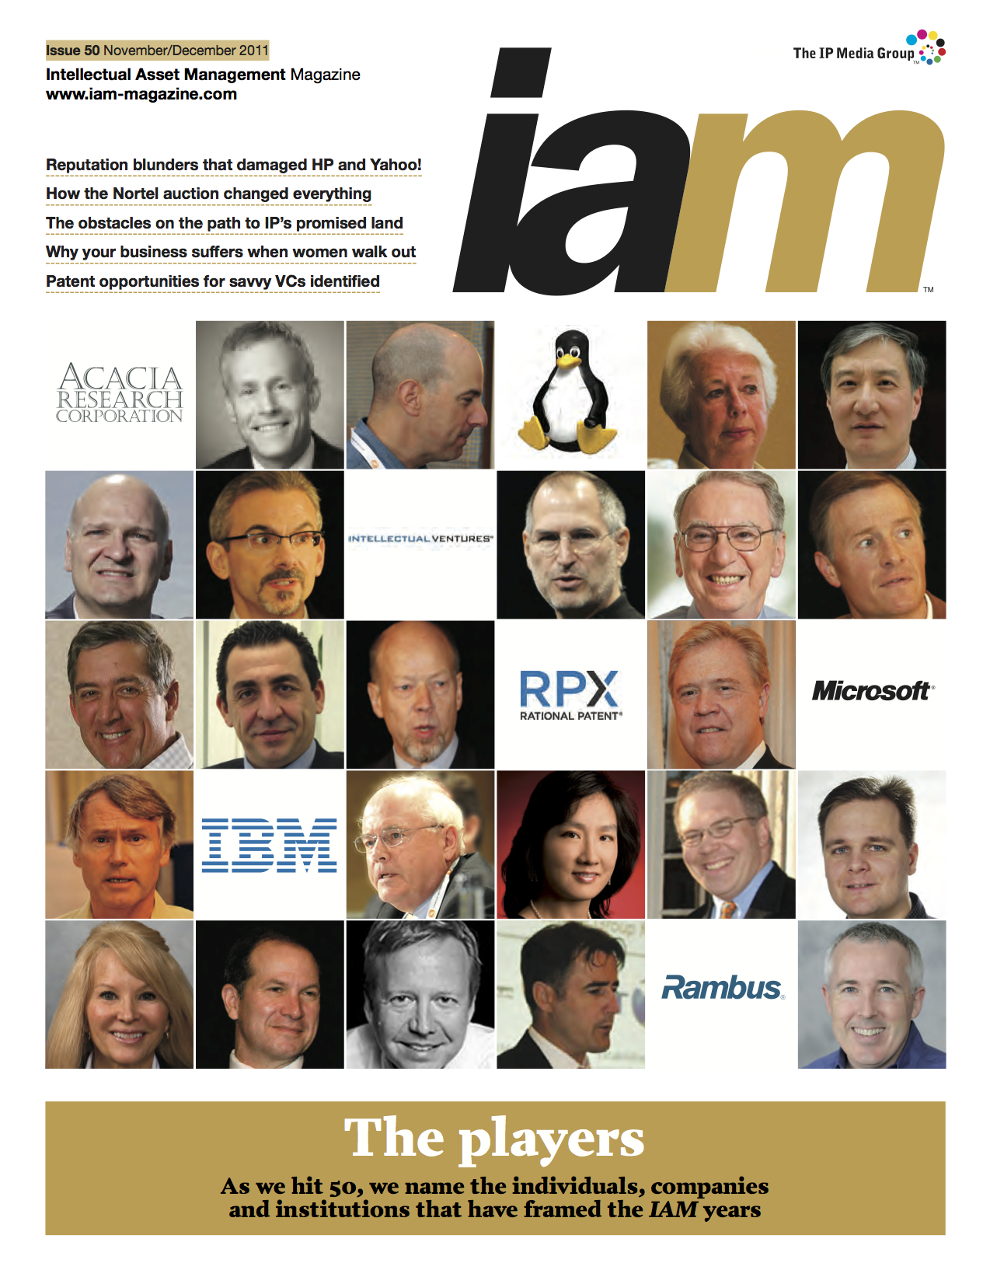
Joe Beyers - IAM Magazine covers - one of the premier IP magazines
Intellectual Asset Magazine
Notes:
2

Slide 3
Inventergy Innovations, LLC
Joe Beyers – Chairman
Technologist
Patents on desktop computing
Inventor of the world's 1st 32-bit computer chip
Business Manager & Entrepreneur
Started 7 Software businesses in HP
Former head of HP’s Internet business unit – $600M/yr. revenue
M&A and business planning – 7 years
Led equity investments, acquisitions and divestitures
Intellectual Property – 6 years
Patent, standards, technology & brand licensing for all of HP
Grew IP income 10X
Company creation/start-up experience
Founder & board member of Allied Security Trust (AST) – 14 member companies
VP at Taligent – Joint Venture of Apple, HP & IBM
Spun out technology from HP and started 8 companies in his last 4 years Medical Devices, IC Technology and Solar Technology
Founding Chairman and former CEO of Ambature, LLC
Co-Founder and Chairman of Silicon Turbine Systems, Inc.
Founder, Chairman and CEO of Inventergy Global, Inc
Intellectual Asset Magazine
Notes:
3

Slide 4
Inventergy Innovations, LLC
Ken Cannizzaro – CEO
Technologist
Industry’s first real time Unix operating system
Industry’s first Unix Notebook computer
Business Manager & Entrepreneur
Business executive and intellectual property professional
Founding member multiple - software /hardware /service companies
Former Managing Director of HP’s Intellectual Property -
Hundreds of millions of dollars in transactional revenues
M&A and business planning – 10 years
Led equity investments
Technology & IP transfers, acquisitions and divestitures
Intellectual Property – 15 years
Intellectual property strategies, patent, standards, technology & brand licensing for industry leading multinational firms to venture-financed startups
Intellectual property experience in creation of hundreds of millions of dollars in transactional experience.
Company creation/start-up experience
Founding member of Massachusetts Computer Inc.
Founding member of Tadpole Technology
Founded Technology Services
CEO of e*star
Co-founded Danzante Destination Eco-Resort (Baja Mexico)
Founding member of IPVALUE Management
Notes:
4

