Slide 1

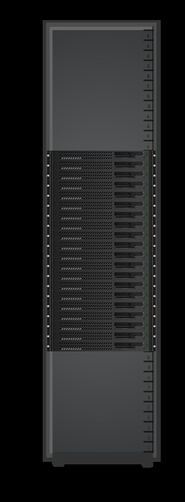
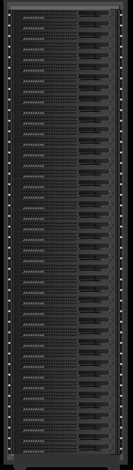
Conventional Rack vs Lopoco
12.5 kW Rack
4.4 kW Rack
Conventional | Item | Lopoco
Dell R720 | Server | LP-6200
Intel E5-26xx | Processor | Intel E5-26xx
20 of 2U | # servers | 40 of 1U
1X | Throughput | 1X
10.0 kW | Power TDP | 4.1 kW
4.0 kW | Power Idle | 1.5 kW
up to 256 GB | Memory | up to 256 GB
up to 8 | Drives | up to 10
up to 6 | Network Connections | up to 6
Intel | NIC chipset | Intel
1X | Equipment Cost | < 1X
$50,000 more | 3 Year Operating Cost | Lowest
Same internal parts => no compatibility issues
Designed for energy efficiency => save $$$

