Slide 1
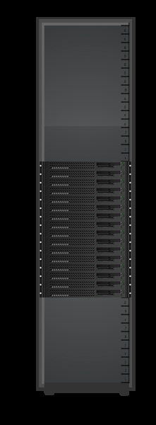
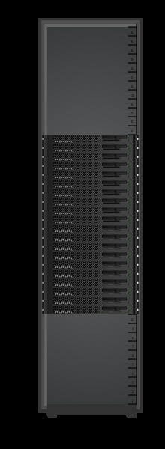
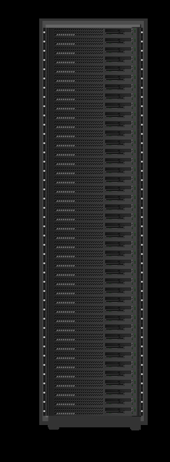
Conventional Rack vs Lopoco
Equal Throughput
Two Racks each 12.5 kW
One Rack
4.4 kW
Conventional | Item | Lopoco
Dell R720/HP DL380 | Server | LP-6240
Intel E5-26xx | Processor | Intel E5-26xx
up to 256 GB | Memory | up to 512 GB
up to 8 | Drives | up to 10
up to 6 | Network Connections | up to 6
Intel | NIC chipset | Intel
36 of 2U | # servers | 40 of 1U
1X | Throughput | 1X
21.6 kW | Power TDP | 4.1 kW
9.0 kW | Power Idle | 1.5 kW
Baseline | Equipment Cost | $90k/156k less
Baseline | Operating Cost | $129,000 less
16
20
40
servers
servers
servers
Same internal parts => no compatibility issues
Designed for energy efficiency => save $$$

