Slide 1
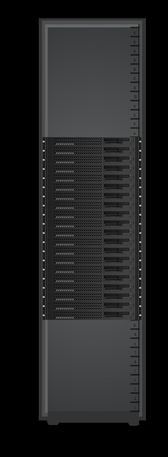
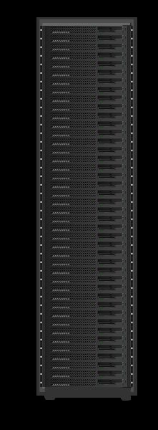

Conventional vs Lopoco
12.5 kW Rack
4.4 kW Rack
Conventional | Item | Lopoco
R720 | Server
Intel E5-2650 | Processor | Intel E5-2630L
25 | # servers | 40
 | Throughput
 | Cores
 | Power Total | 4.1 kW
 | Power TDL
 | Power Idle
Up to 256 GB | Flash Memory | Up to 256 GB
 | Drives | 10
 | Network Connections
Intel xxx | NIC chipset | Intel xxx
Yes | Front panel access | Yes
$ 100,000 | Equipment Cost | $ 100,000
 | Energy Cost
Same internal parts => no compatibility issues. Designed for Internet traffic => save $$$

