Slide 1
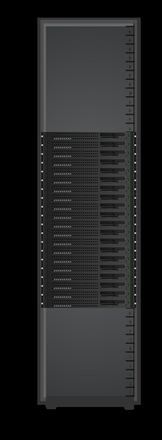

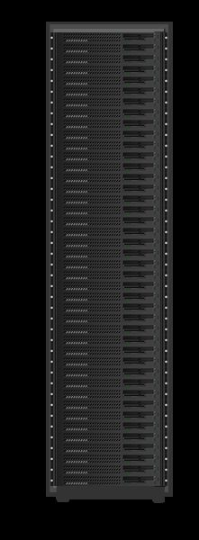
Conventional vs Lopoco
12.5 kW Rack
Conventional | Item | Lopoco
R720 | Server | LP-6200
Intel E5-2650 | Processor | Intel E5-2630L
20 | # servers | 40
12 kW | Power TDP | 4.4 kW
5 kW | Power Idle | 1.4 kW
Up to 256 GB | Memory | Up to 256 GB
Up to 8 Hot Swap | Drives | Up to 10 Hot Swap
1 to 6 | Network Connections | 2 to 6 + IPMI/nKVM port
Intel | NIC chipset | Intel
$ 8,600 | Cost per server | $ 5,500
$2,000/mo | Cost To Operate | $800/mo
 | Savings | $50,000 3yrs.
1x | Throughput | 1.55x
4.4 kW Rack
Same internal parts => no compatibility issues.
Designed for Internet traffic => save $$$

