Slide 1
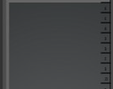
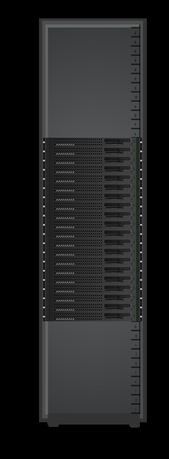
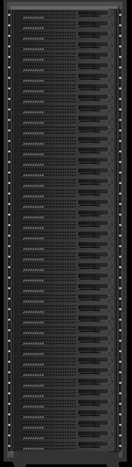

Lopoco – Company Profile
Ultra-Efficient Server designer & manufacturer (www.lopoco.com)
    ¼ the power usage of conventional servers
  Standard processors, memory & drives; Standard contract manufacturers
  Broad installed base – Zero field failures
  “Most Efficient Server” ever certified by experts Power Assure Corporation
  Designed for use with existing servers & racks – no compatibility issues
Silicon Valley headquarters. Founded 2010 by Intel, Sun, HP industry veterans
  Customer Benefits
    Save money - >50% less Data Center energy costs & lower server cost
    Save space – use fewer racks
    Save energy – realize Green computing
    Run cool and quite - producing much less heat and vibration, the two causes of most server failures
Conventional Servers vs Lopoco
Equal Throughput
Two Racks each 12.5 kW
One Rack
4.4 kW
Conventional | Item | Lopoco
Dell R720 | Server | LP-6200
Intel E5-26xx | Processor | Intel E5-26xx
up to 256 GB | Memory | up to 256 GB
up to 8 | Drives | up to 10
up to 6 | Network Connections | up to 6
Intel | NIC chipset | Intel
36 x 2U | # servers | 40 x 1U
1X | Throughput | 1X
21.6 kW | Power TDP | 4.1 kW
9.0 kW | Power Idle | 1.5 kW
Baseline | Equipment Cost | $90,000 less
Baseline | Operating Cost | $129,000 less
Conventional
16
20
40
servers
servers
servers
Same internal parts => no compatibility issues
Designed for energy efficiency => save $$$

