Slide 1
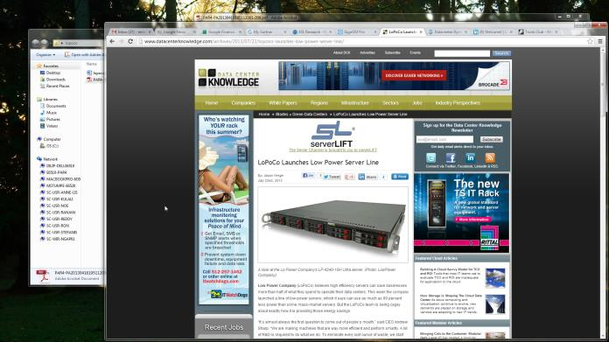
PAR4 – Energy Efficiency Certification
Model | CPU | IDLE | LOADED | RACK | Transaction Per Watt
HP DL385-G2 | Dual AMD Opteron64 2216HE 2.4GHz 32GB Memory | 278W | 368W | 7360W 20 per Rack 980MTxn | 133,000
HP DL160 G6 | Intel L5520 Quad Core, 2.27GHz 12GB Memory | 113W | 197W | 7880W 40 per Rack 4,280MTxn | 543,000
Supermicro 6016 | Intel L5518 Quad Core, 2.13GHz, 8GB Memory | 132W | 217W | 8680W 40 per Rack 4,120MTxn | 516,000
Dell CS24-SC | Intel L5420 Quad Core, 2.5GHz, 8GB Memory | 83W | 157W | 6280W 40 per Rack 4,400MTxn | 700,000
Lopoco LP-4240 6H | Intel Xeon Quad Core 2.4 GHz 16GB Memory | 29W | 74W | 2963W 40 per Rack 3,540MTxn | 1,194,000

