Slide 1
Inventergy Innovations
Lopoco Invention Workshop
Whiteboard Documentation
Workshops 8/9/2016,8/11/2016

Slide 2
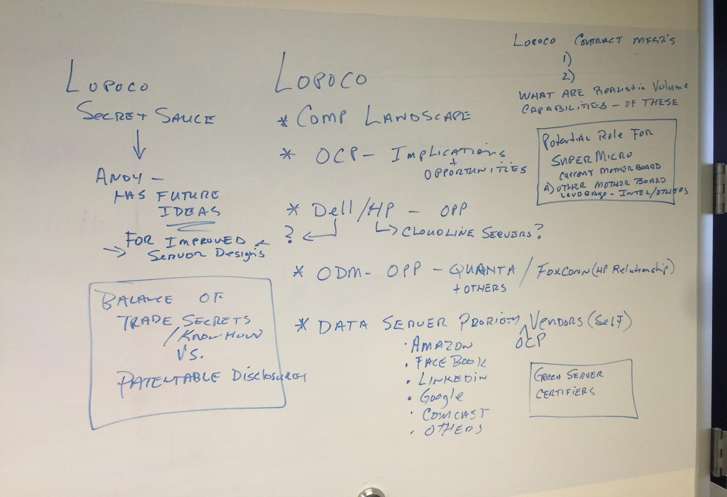
Notes:
Landscape of Lopoco – secret sauce, ideas for improved server designs, ask Marc about balance of patentable information vs technical know how; the test procedure is copywriteable but is the creation of planform patentable

Slide 3
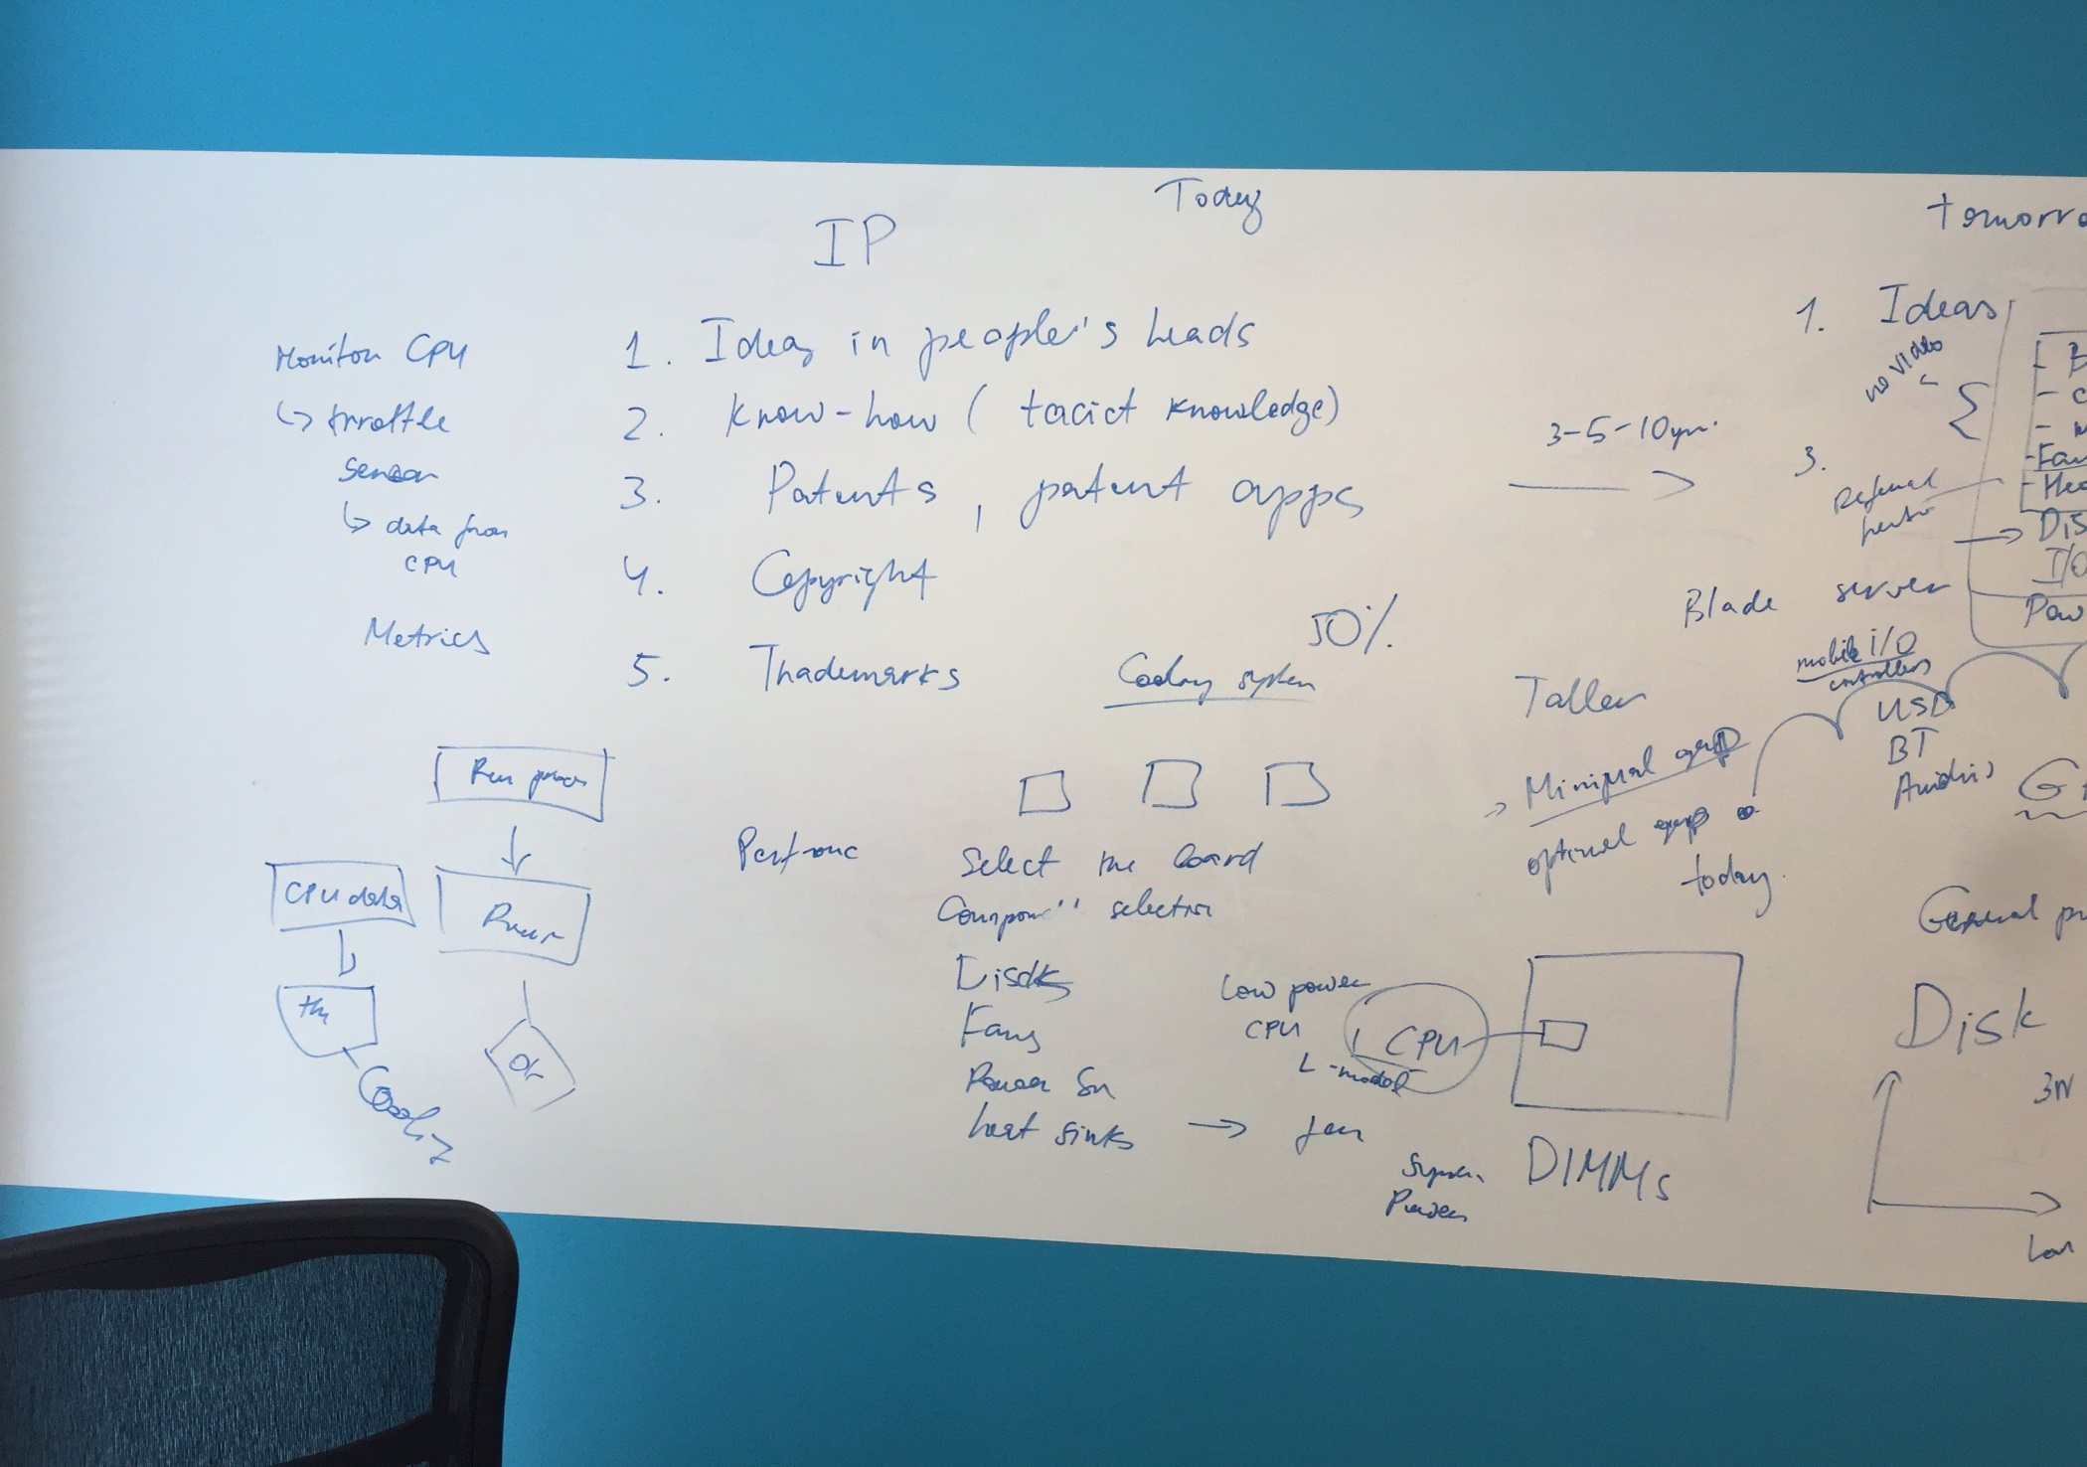

Slide 4
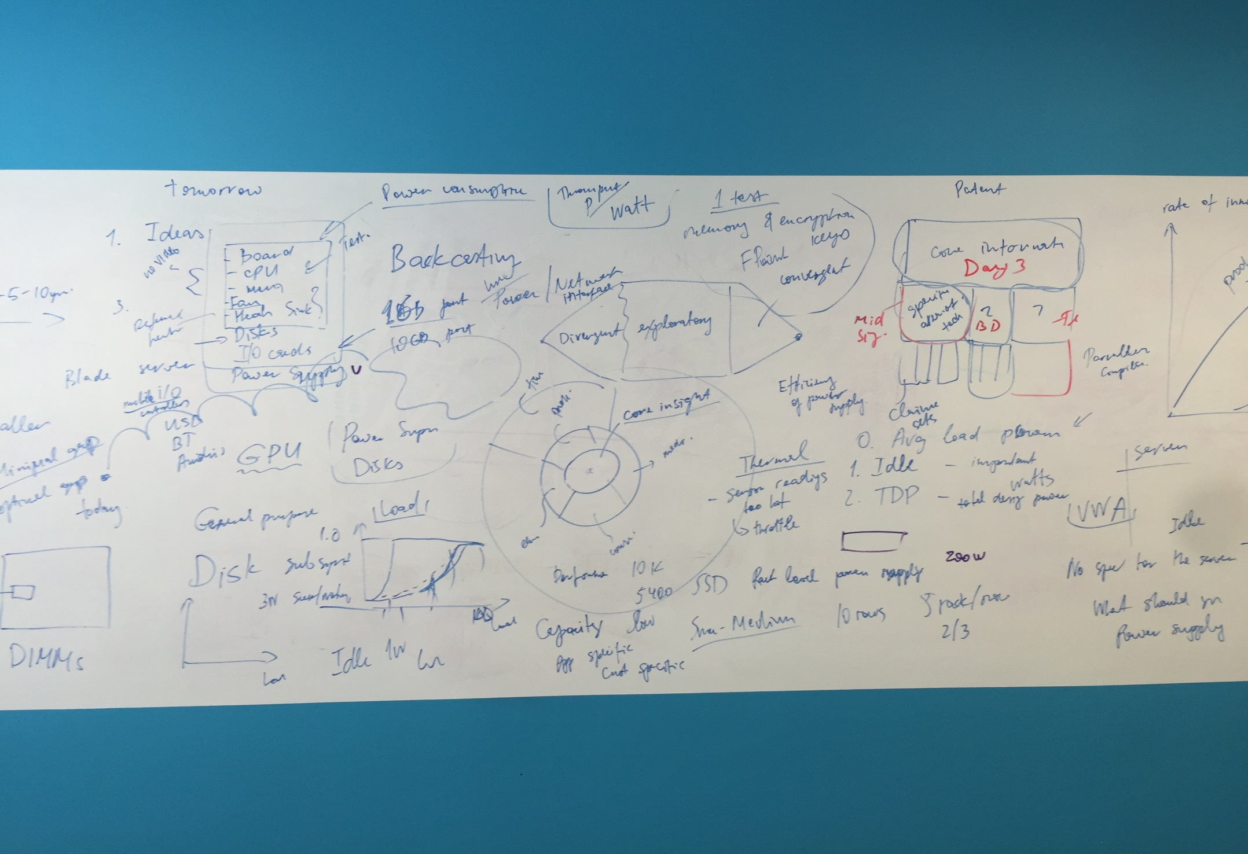

Slide 5
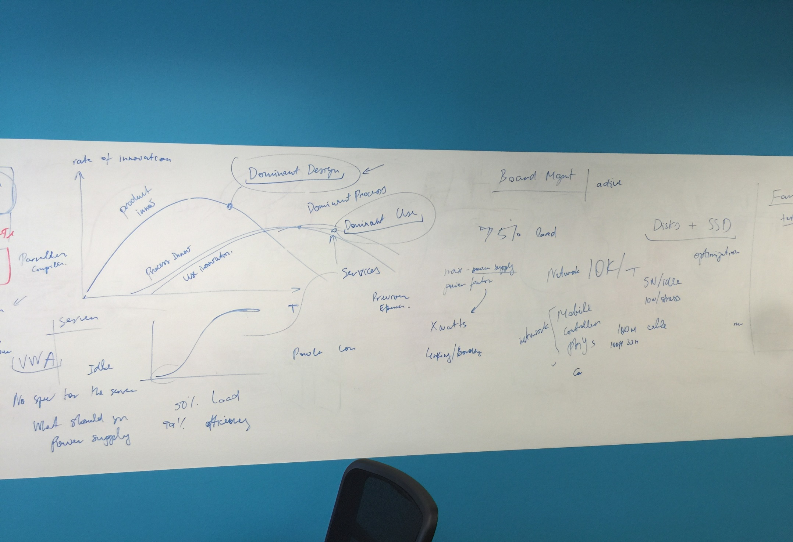

Slide 6
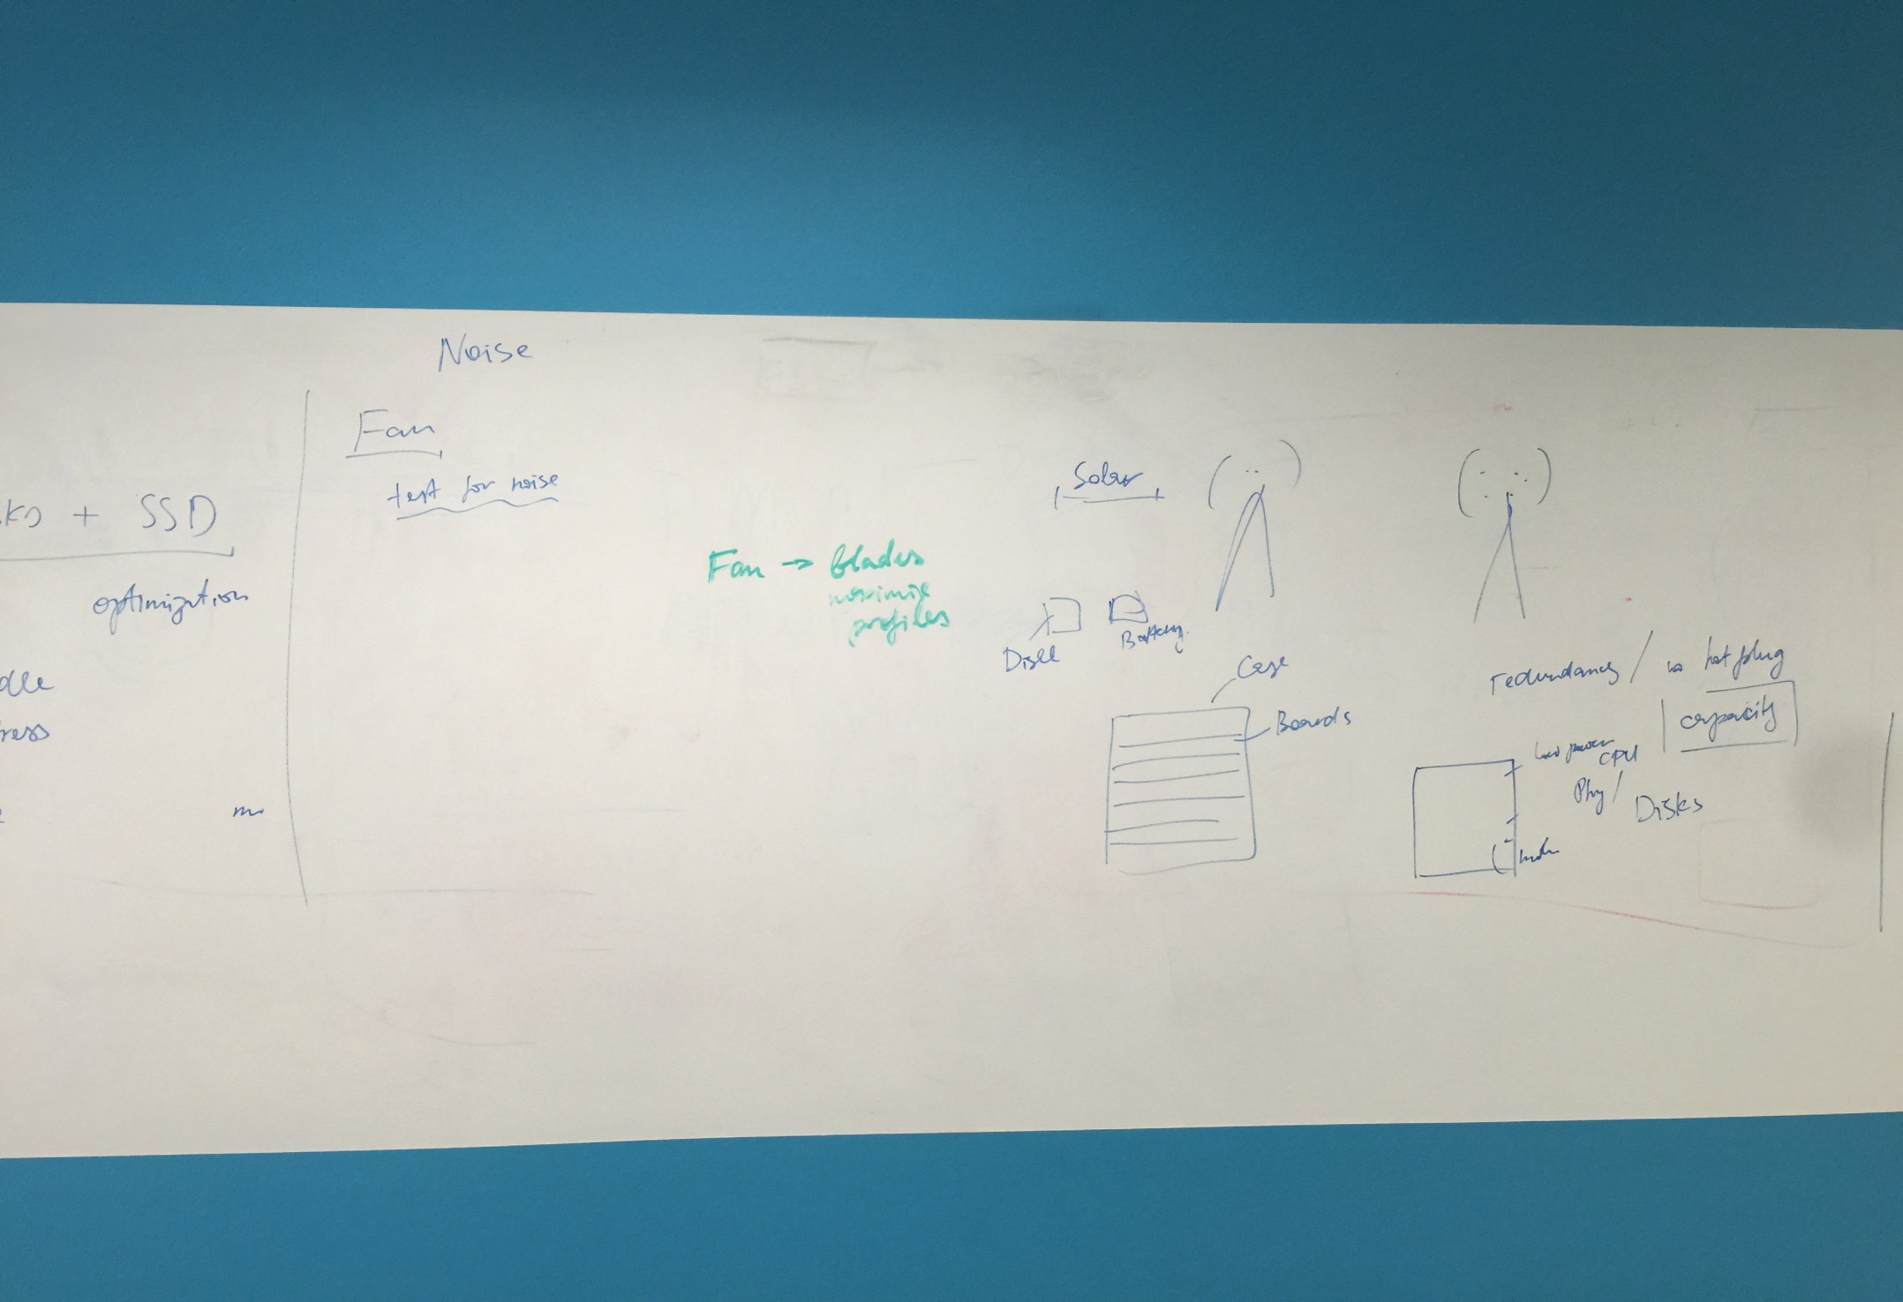

Slide 7
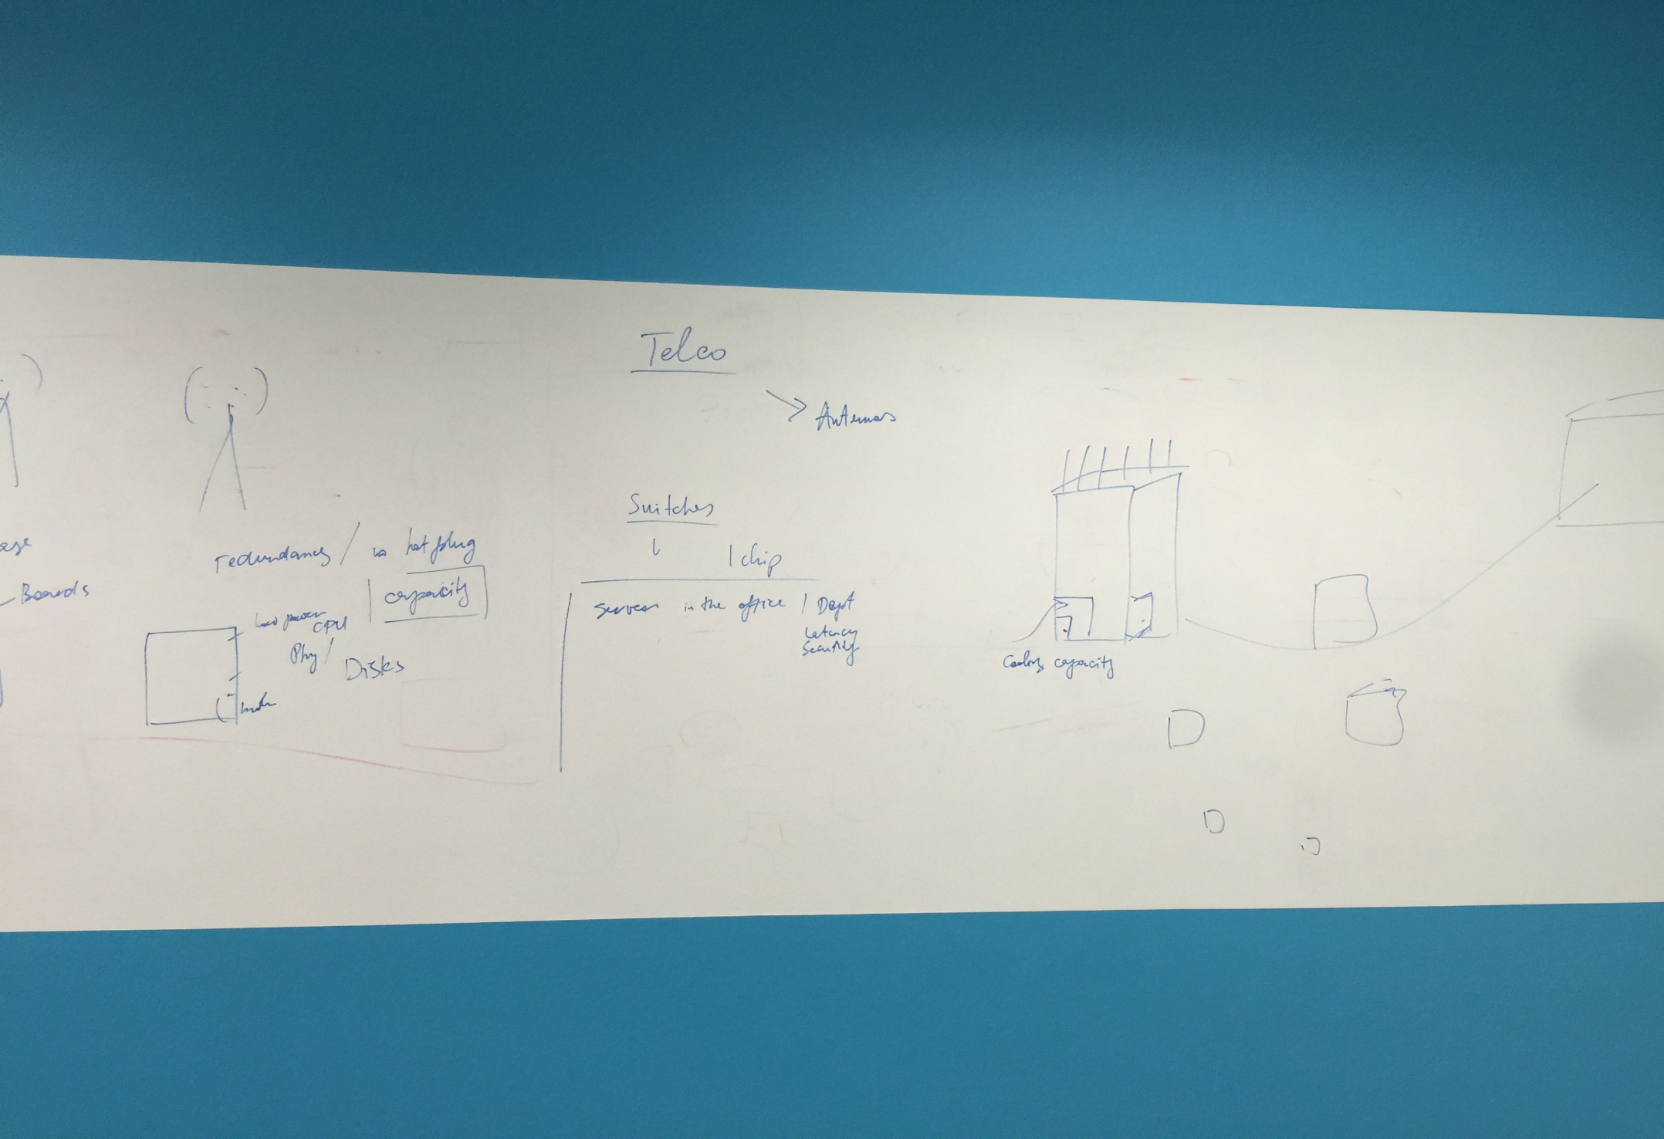

Slide 8
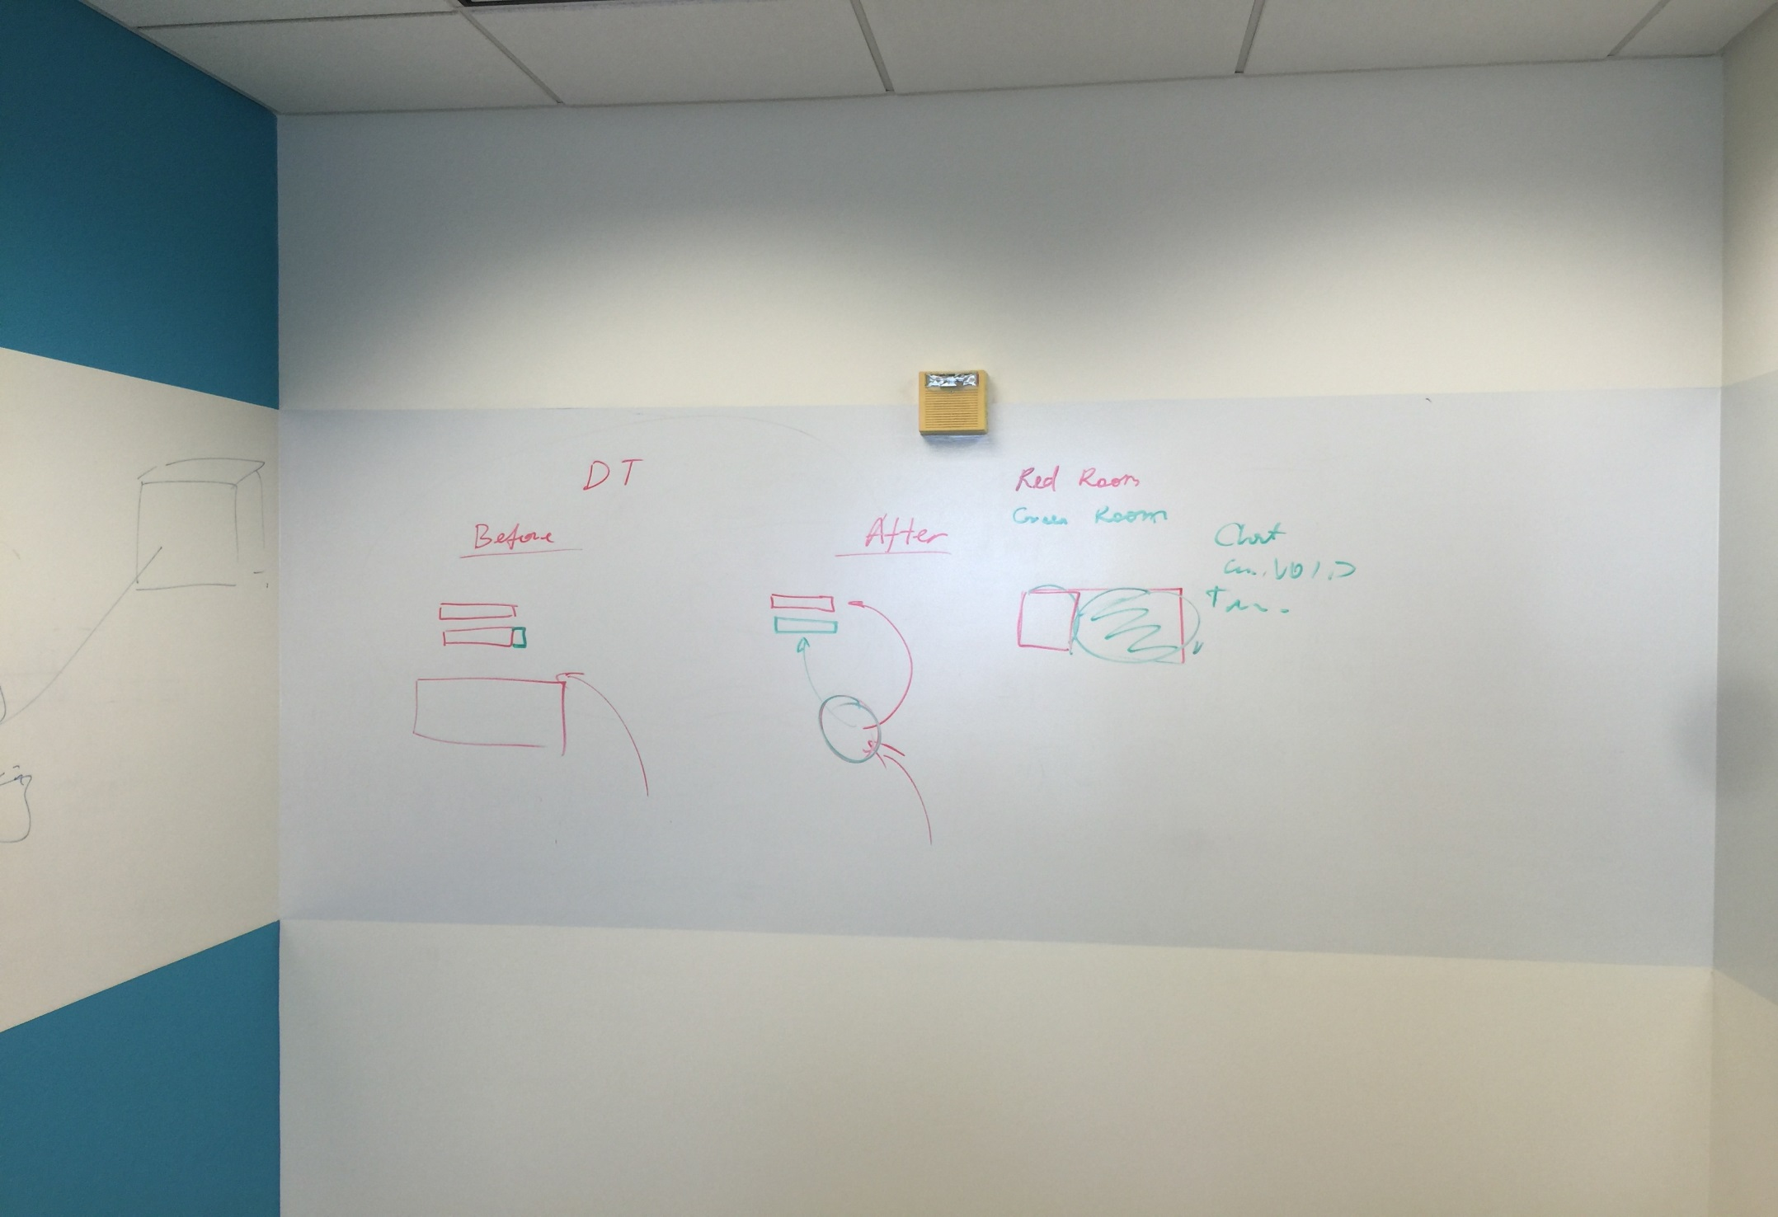

Slide 9
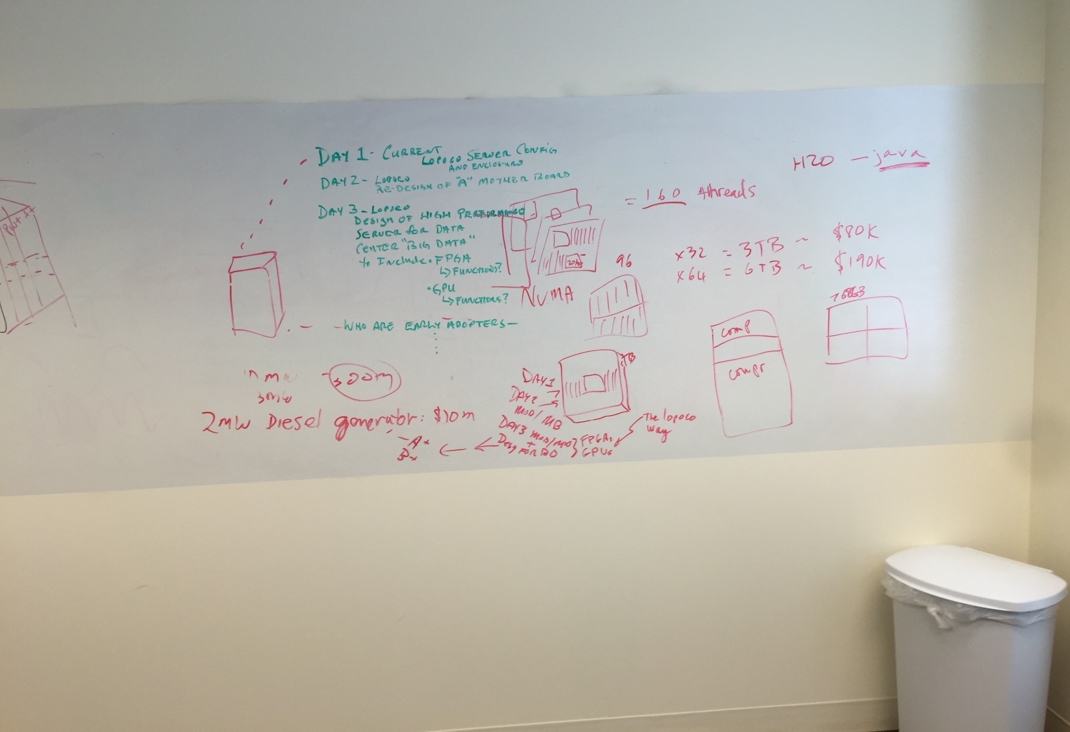

Slide 10
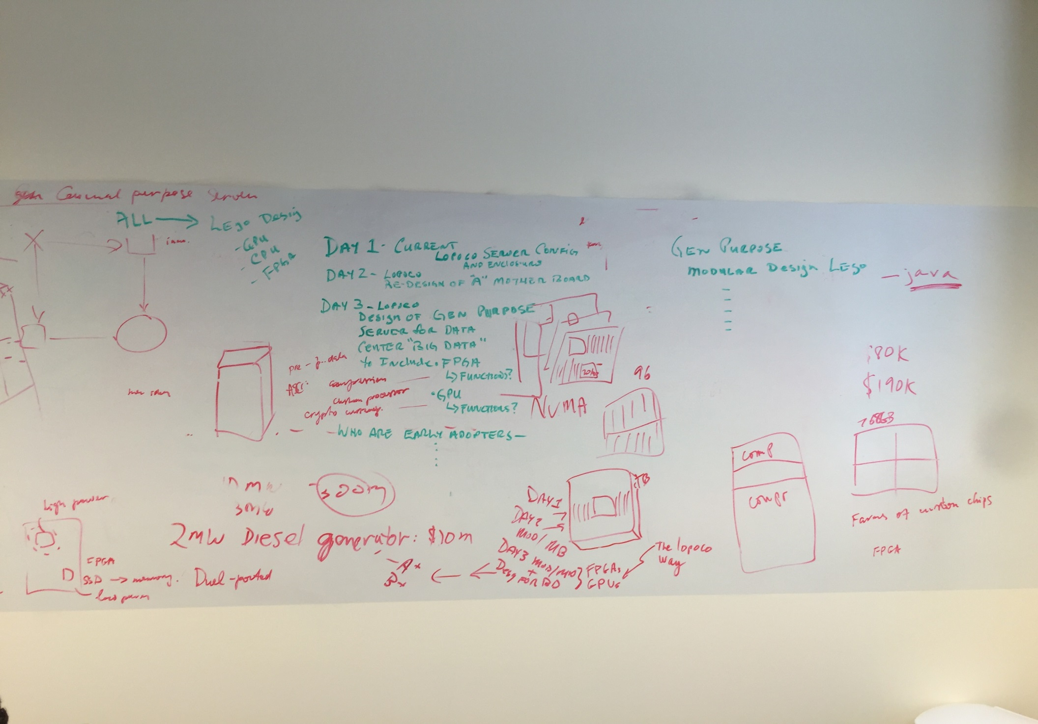

Slide 11
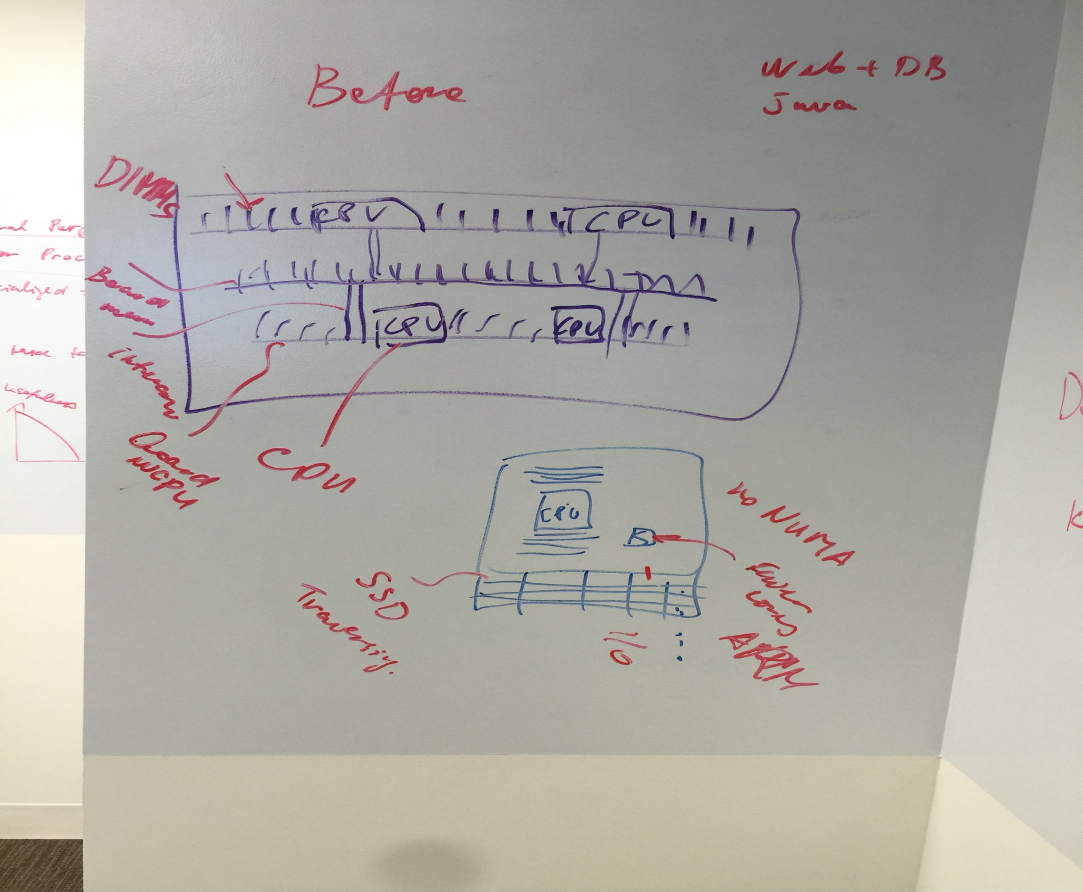

Slide 12
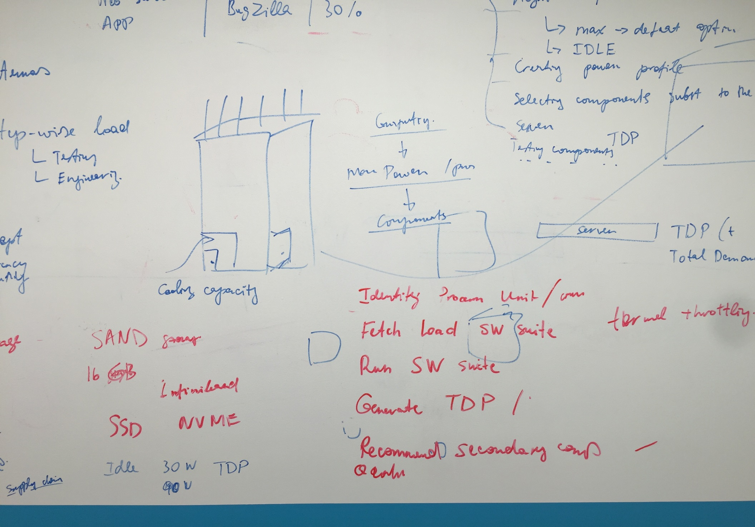
Notes:
Embodiment…. Red flow chat Red denotes the process flow to generate total design power to then create the recommended configuatoin.

Slide 13
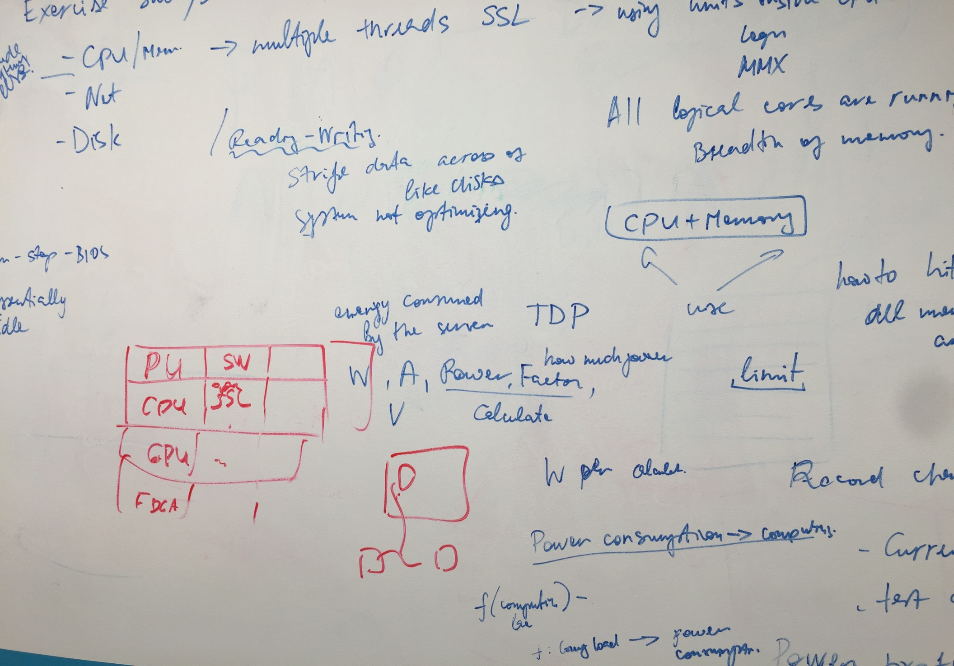

Slide 14
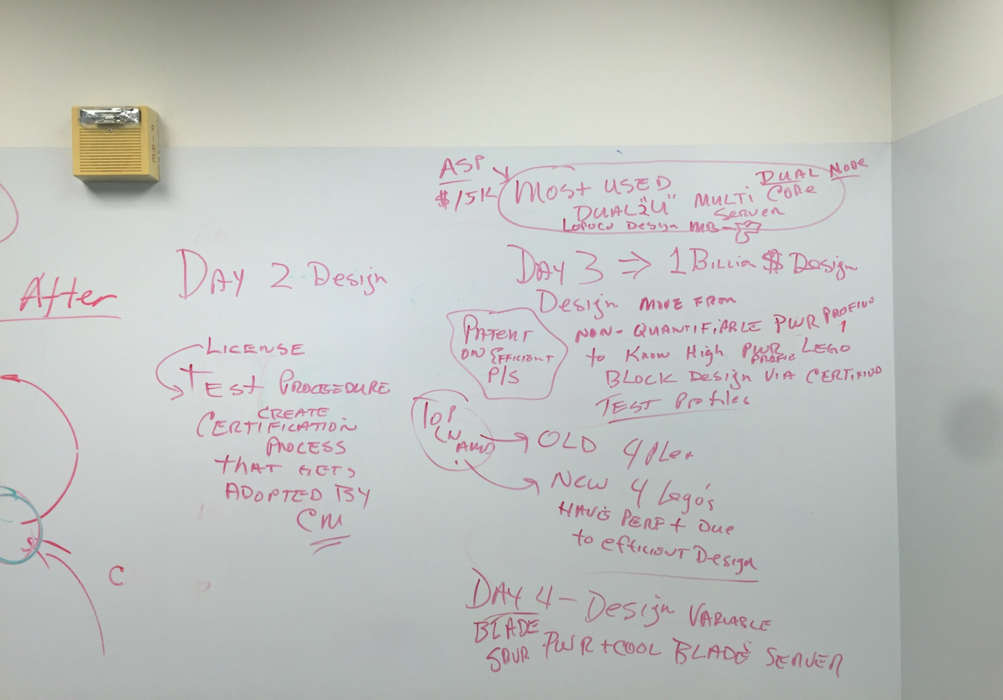
Notes:
License the test procedure to create a certification process that gets adopted by CM’s

Slide 15
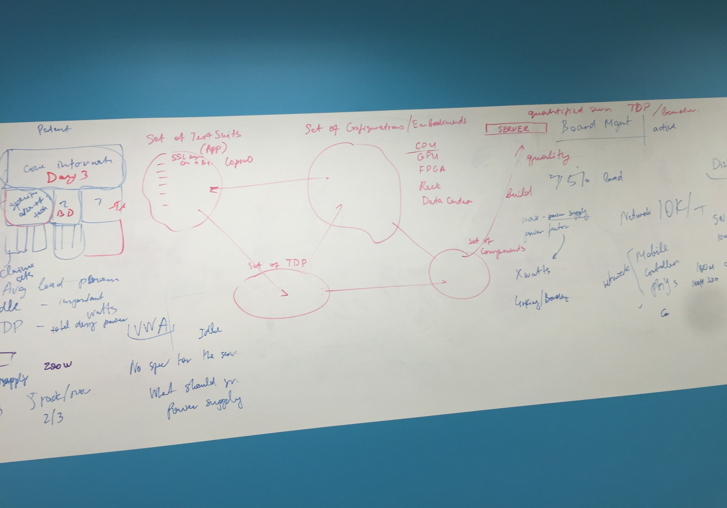

Slide 16
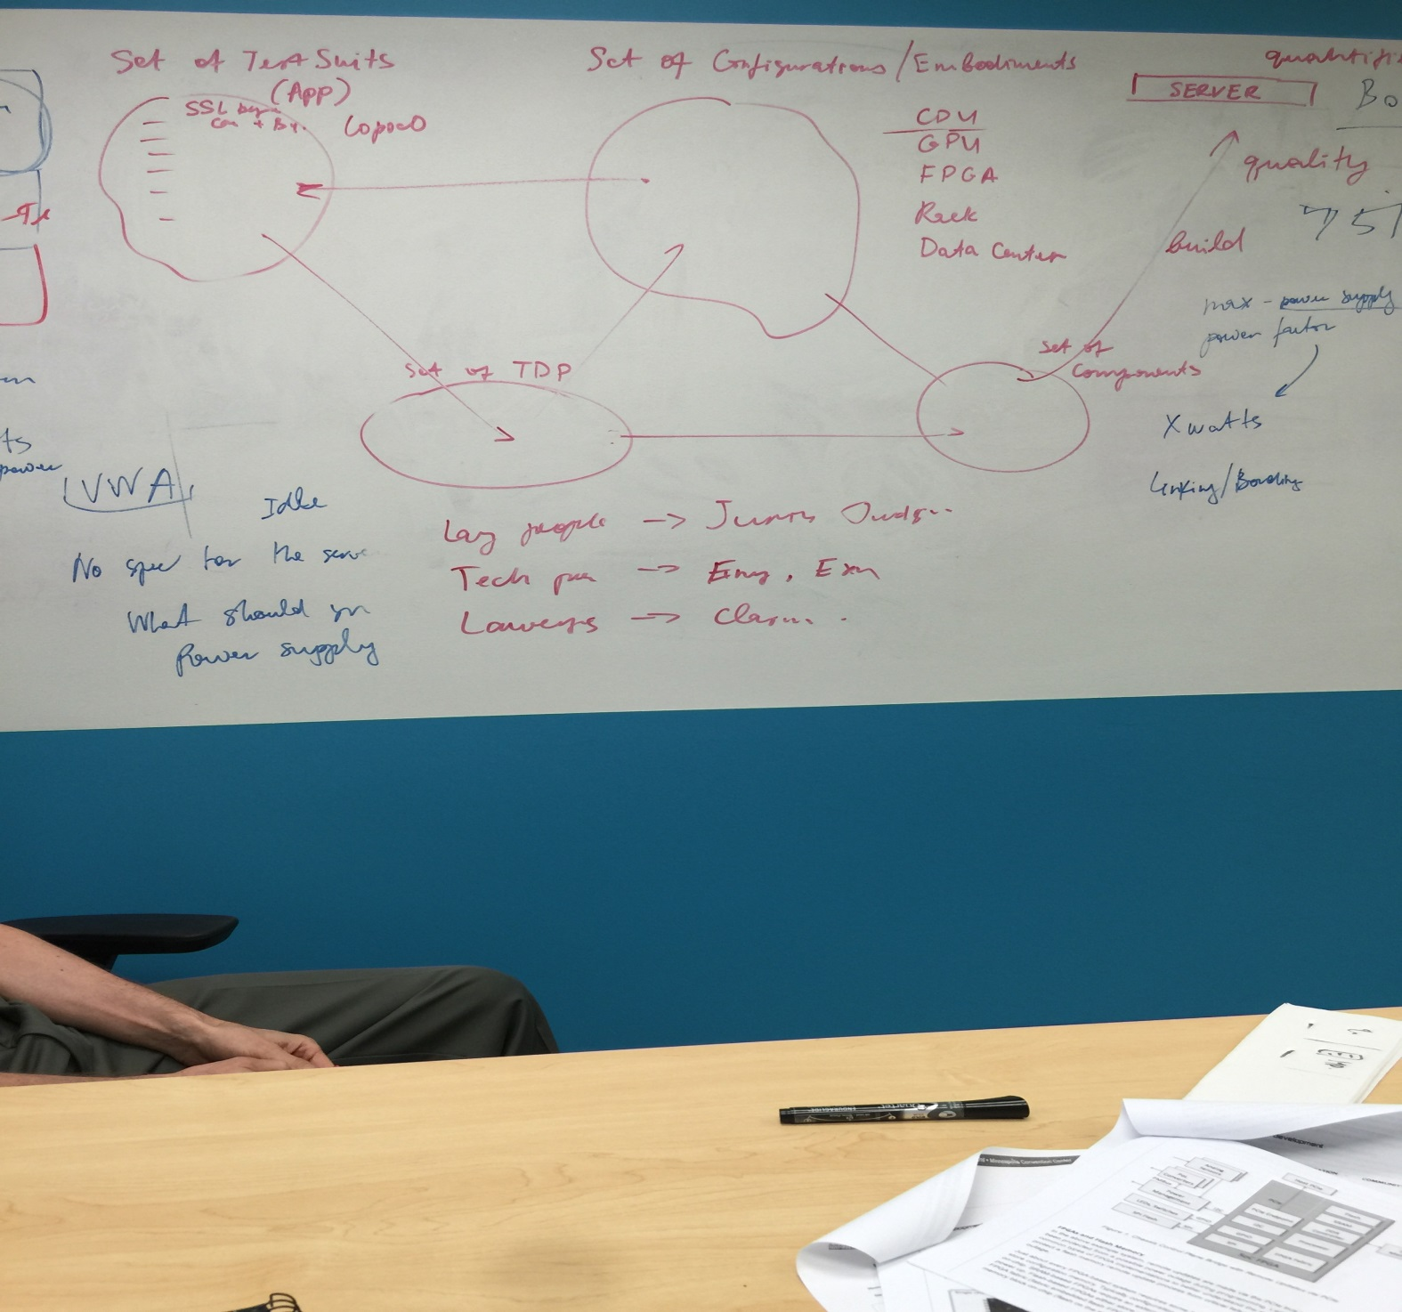

Slide 17
