Slide 1
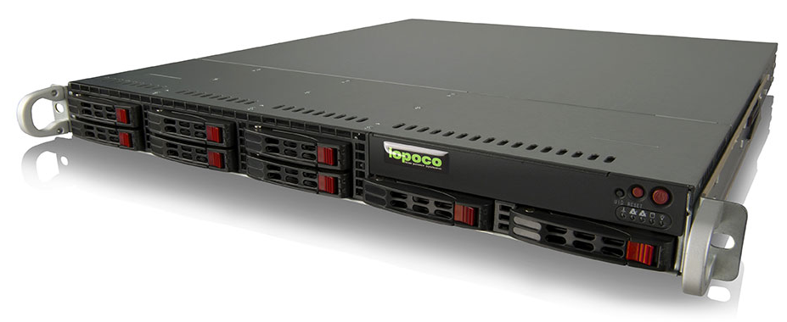
Ultra Efficient Green-Tech Servers Shipping Now

Slide 2
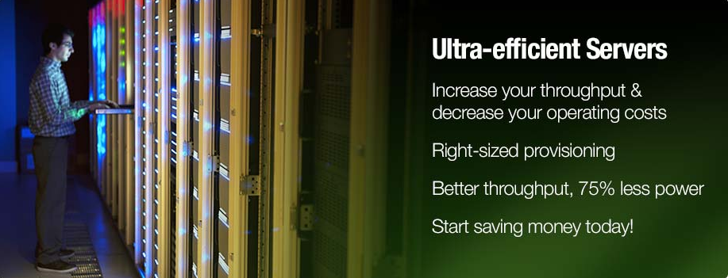
Proven Technology
Lopoco designs and manufactures ultra-efficient, green-tech servers that provide substantial energy and cost savings without sacrificing performance. They are built on proven, shipping technology without costly custom chips or strange form factors.
Irresistible Value Proposition
When HVAC cost savings, higher availability and better opportunity costs are factored in, lopoco servers are an irresistible value proposition.
Power Efficiency Expertise
Lopoco’s years of refining and implementing patented techniques has produced the industry’s most power efficient Servers that still deliver the needed performance for those demanding workloads.

Slide 3
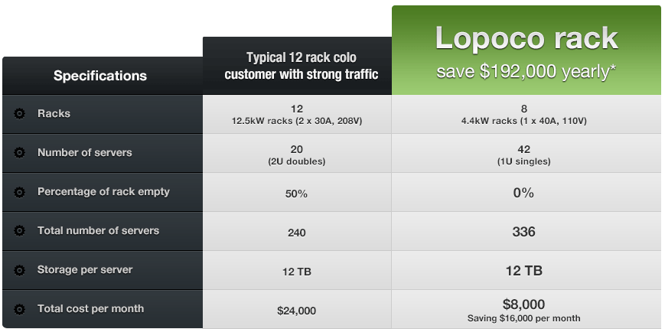
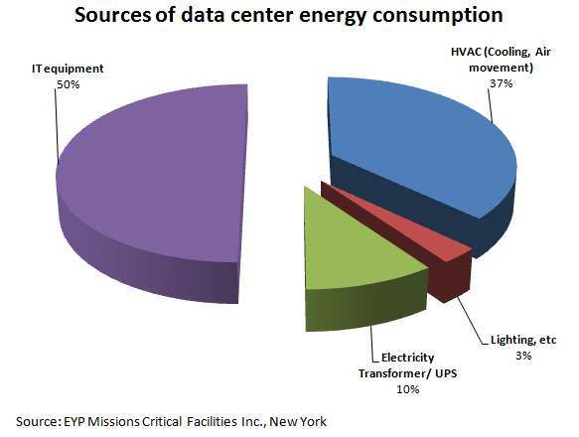
Server - Operating Cost Comparison

Slide 4
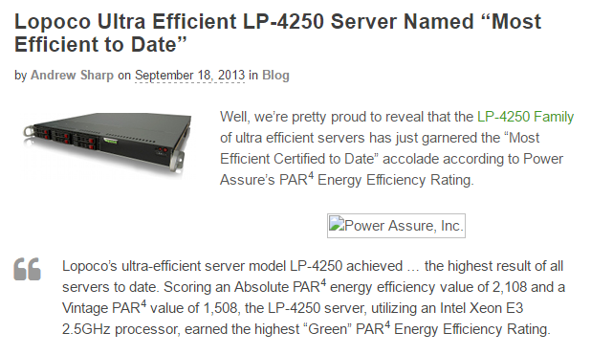
Lopoco’s History
Established 2012
<.8% in-the-field failure rate
Installed customer base
Recognized for their Power Efficiency

Slide 5
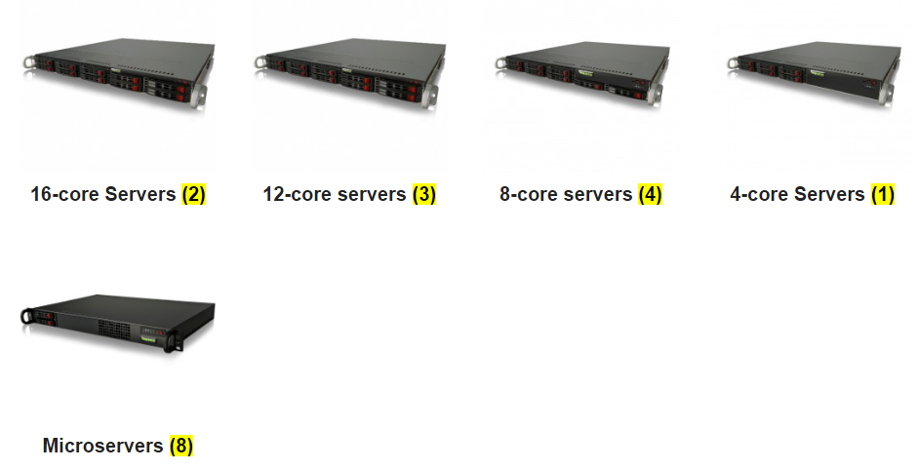
Lopoco Current Products
Lopoco designs and manufactures ultra-efficient, green-tech servers that provide substantial energy & cost savings without sacrificing performance. Servers are built on proven (and shipping) technologies without the use of any costly custom chips or nonstandard form factors.
Typical General Purpose Servers
HPC
Performance Range
Performance Range
Lopoco Servers
Typical Power Efficient Servers

Slide 6
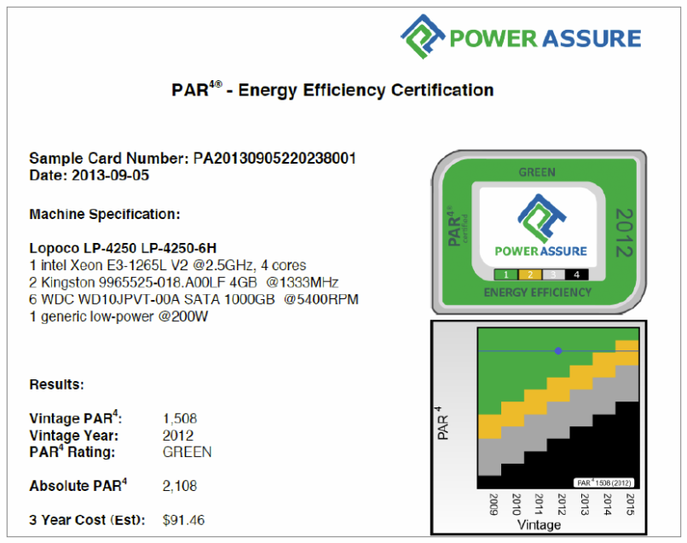
Lopoco – Energy Efficient Servers

Slide 7
Lopoco - Power Efficient Server Technology Suite
Air flow management
Power supply optimization
Fan utilization & optimizations
Disk Drive configurations
Application class zones
Application Management Software
Efficient Motherboard design/layout
BIOS optimizations
Lopoco Total Design Power Software (TDP)
A subset of these technologies have already produced substantial benefits in Lopoco Servers…
…but many efficiency improvements still remain.

Slide 8
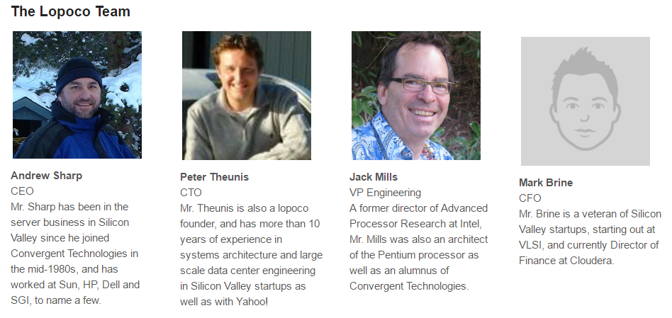
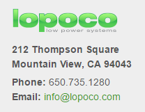
The Lopoco Team

Slide 9
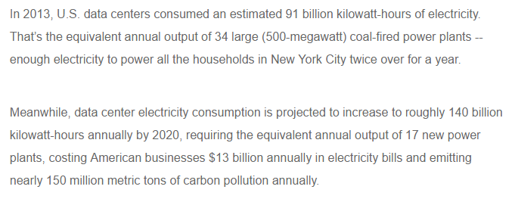
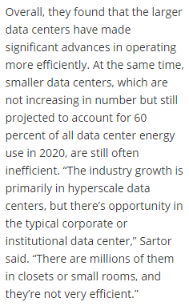
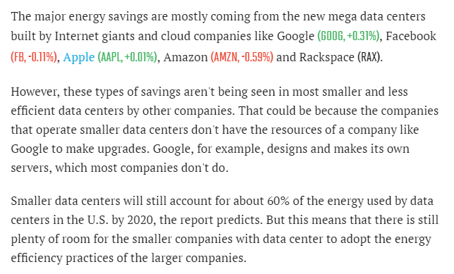
Market Opportunity
A 10% savings is worth $1.3B annually in US only
https://www.nrdc.org/experts/pierre-delforge/new-study-americas-data-centers-consuming-and-wasting-growing-amounts-energy
http://newscenter.lbl.gov/2016/06/27/data-centers-continue-proliferate-energy-use-plateaus/
Huge market in small/medium businesses
Huge market in small/medium businesses
http://fortune.com/2016/06/27/data-center-energy-report/
60% of market are small/medium businesses

Slide 10
Contact Information
Ken Tallo
Inventergy - Director, Business Development Representing Lopoco
916.172.6302 (m)
ktallo@inventergy.com
Cliff Loeb Inventergy - Director, Business Development Representing Lopoco
970.214.7491 (m) / 970.214.7491 (o)
cliff@inventergy.com
Lopoco
212 Thompson Square Mountain View, CA 94043
Tel: 650.735.1280
www.lopoco.com
Email: info@lopoco.com

