Slide 1
Ultra Efficient Green-Tech Servers
Represented by:
Maximizing the Value of Your Intellectual Property
April 2017

Slide 2
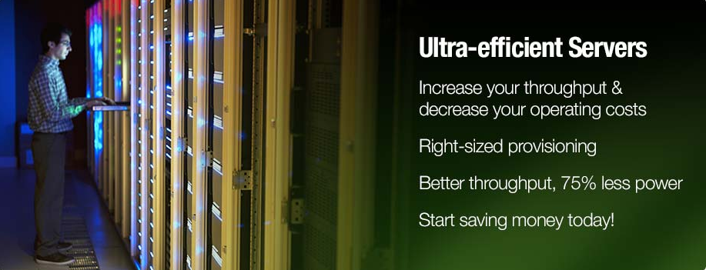
Need to validate this 75% claim
Proven Technology
Lopoco designs and manufactures ultra-efficient, green-tech servers that provide substantial energy and cost savings without sacrificing performance. They are built on proven, shipping technology without costly custom chips or strange form factors.
Irresistible Value Proposition
When HVAC cost savings, higher availability and better opportunity costs are factored in, lopoco servers are an irresistible value proposition.
Power Efficiency Expertise
Lopoco’s years of refining and implementing patented techniques has produced the industry’s most power efficient Servers that still deliver the needed performance for those demanding workloads.

Slide 3
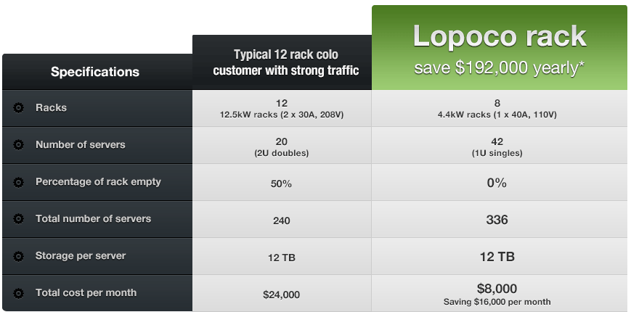
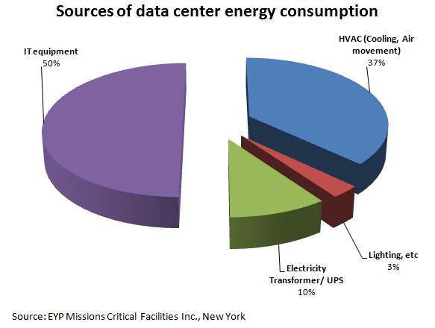
Operating Cost Comparison
Need to validate this $192K claim
Look at Andy white paper
CapEx vs OpEx
Blah
Blah
Blah

Slide 4
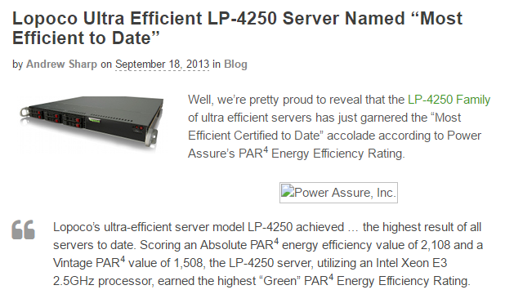
Lopoco’s History
Established 2012
<.8% in-the-field failure rate
Several customers
Recognized for their Power Efficiency
This is old, and using a PAR metric that does not seem to be used widely.
Consider removing this slide

Slide 5
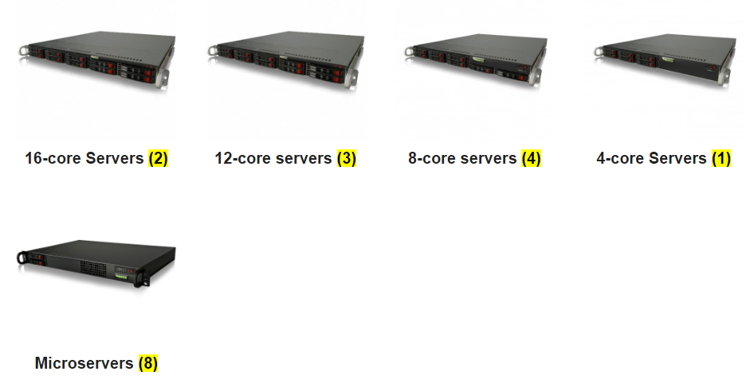
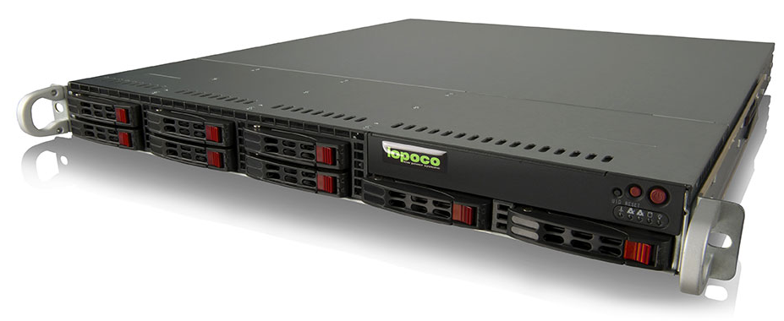
Lopoco Current Products
Lopoco designs and manufactures ultra-efficient, green-tech servers that provide substantial energy & cost savings without sacrificing performance. Servers are built on proven (and shipping) technologies without the use of any costly custom chips or nonstandard form factors.
Consider adding more details on the Servers
Delete or detail the (#)
HPC
Typical Servers
Lopoco Servers
Pwr Eff

Slide 6
Lopoco Current Products
Lopoco designs and manufactures ultra-efficient, green-tech servers that provide substantial energy & cost savings without sacrificing performance. Servers are built on proven (and shipping) technologies without the use of any costly custom chips or nonstandard form factors.
Consider adding more details on the Servers
Delete or detail the (#)
Typical General Purpose Servers
HPC
Performance Range
Performance Range
Lopoco Servers
Typical Power Efficient Servers

Slide 7
Power Efficient Server Technology Suite
Air flow management
Power supply optimization
Fan utilization & optimizations
Disk Drive configurations
Application class zones
Application Management Software
Efficient Motherboard design/layout
BIOS optimizations
TDP Software
A subset of these technologies have already produced huge benefits…
…but many efficiency improvements still remain.

Slide 8
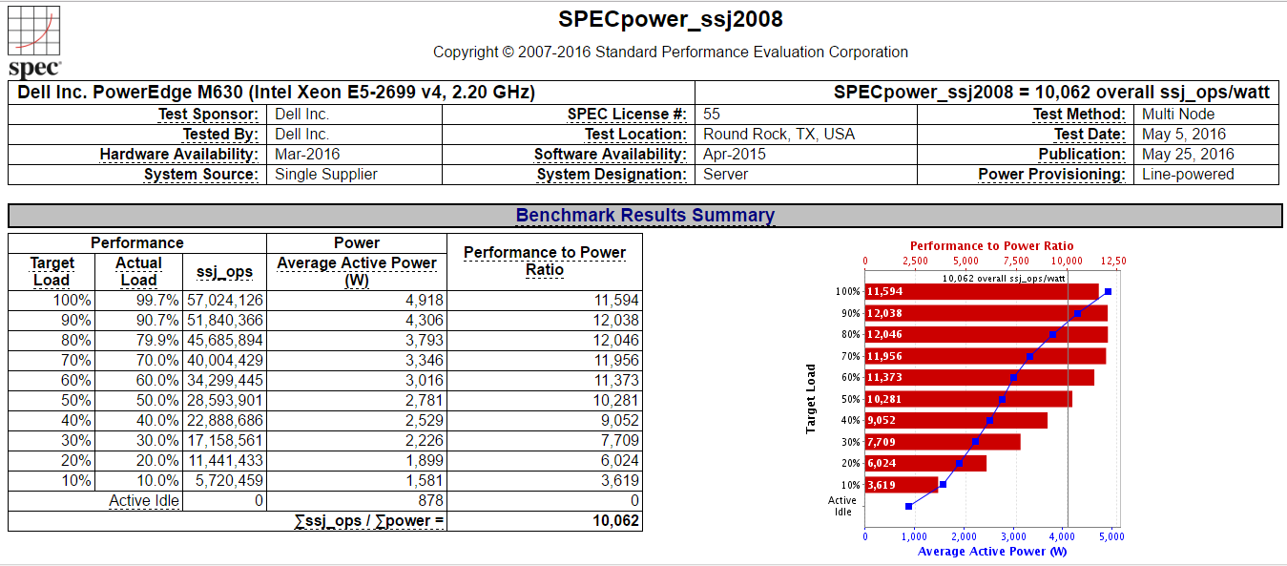
Lopoco Server Power Efficiency Data
Need to update this slide with Andy’s latest SPECpower data, and compare it to HP/Del/HWI
Not up to date

Slide 9
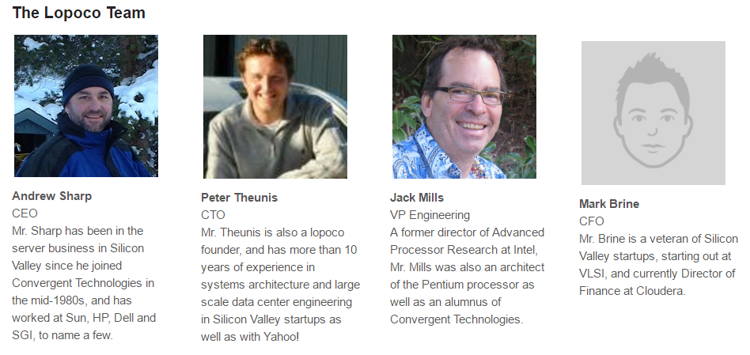
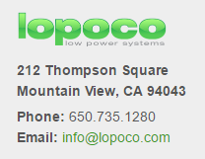
The Lopoco Team
Who is transitioning? Just Andy?
Need phot of Mark is he is key to team, or remove his pic

Slide 10
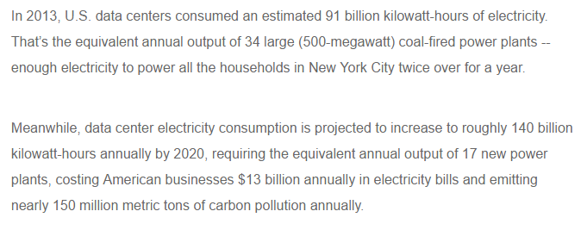
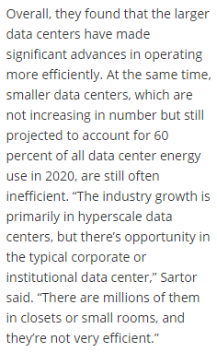
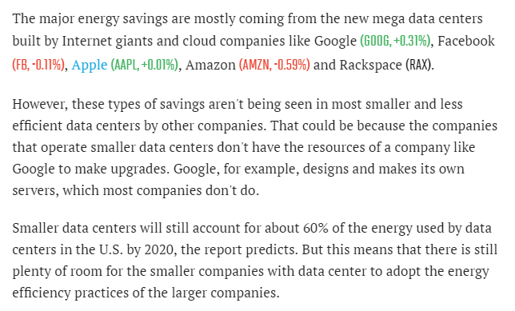
Market Opty
A 10% savings is worth $1.3B annually in US only
Need to use info to set technology value.
I like $1.3B ☺
https://www.nrdc.org/experts/pierre-delforge/new-study-americas-data-centers-consuming-and-wasting-growing-amounts-energy
http://newscenter.lbl.gov/2016/06/27/data-centers-continue-proliferate-energy-use-plateaus/
Huge market in small/medium businesses
Huge market in small/medium businesses
http://fortune.com/2016/06/27/data-center-energy-report/
60% of market are small/medium businesses

Slide 11
Inventergy Innovations Contact Information
Ken Tallo
Director, Business Development
916.172.6302 (m)
ktallo@inventergy.com
Cliff Loeb Director, Business Development
970.214.7491 (m) / 970.214.7491 (o)
cliff@inventergy.com
Inventergy Innovations, LLC
900 E. Hamilton Avenue, Suite 180
Campbell, CA 95008
Office: 408.389.3510
www.inventergy.com
Inventergy Innovation, LLC - An Inventergy Global Inc. Company Copyright 2017 all rights reserved

Slide 12
Dell SPECpower Data (2016)

Slide 13
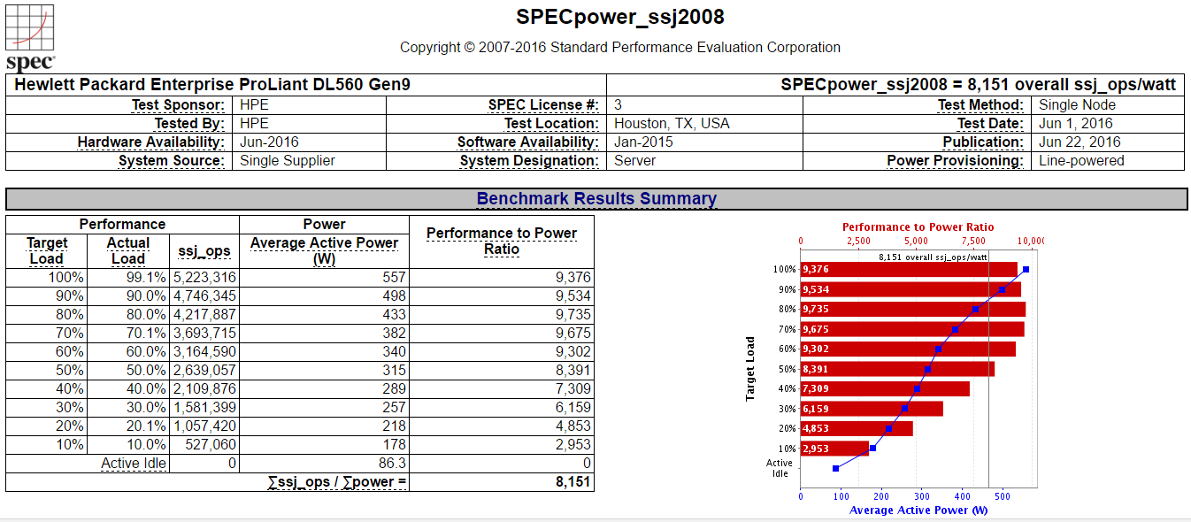
HP SPECpower (2016)

Slide 14
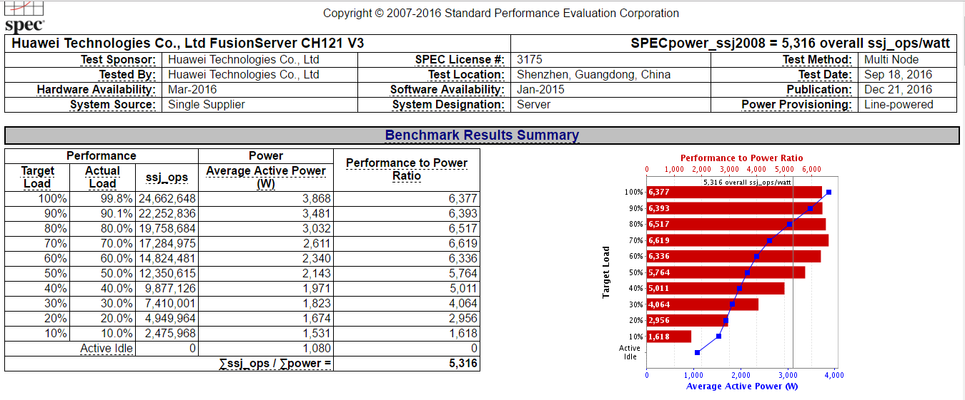
Huawei SPECpower (2016 & 2017)

