Slide 1

Ultra-efficient, Green-tech Servers
sales@lopoco.com

Slide 2
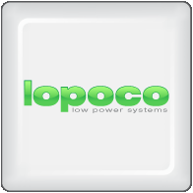
Our Vision
Designing and manufacturing ultra-efficient, green tech servers that provide substantial energy and cost savings without sacrificing performance by using proven, shipping technology without costly custom chips or disruptive form factors.
We aim to substantially decrease the TCO for corporate IT by creating value add server and storage products generating lower heat and less vibration; giving higher density and lower investment required, and substantially lower energy consumption (as much as 75% less).

Slide 3
About Us
Established mid-2010 by a group of Silicon Valley veterans in fields of server, storage, software and CPU design
Delivered first server to customer Q4 2011
Headquartered in the heart of Silicon Valley, California. European legal entity in process to be set-up in Austria, Europe.
Led by founder Andrew Sharp as CEO, a Silicon Valley veteran who joined Convergent Technologies in 1985, and has worked for Sun, SGI, HP and LSI, along with several startups.
Peter Theunis, CTO and co-founder, has more than 10 years of experience in large scale systems architecture at startups and at Yahoo!
Jack Mills, VP Engineering, while at Intel was an architect of the Pentium and the Itanium processors; later Director of advanced processor research; also an alumnus of Convergent Technologies [advisor]
Mark Brine, CFO, is a veteran of Silicon Valley startups, starting at VLSI, later VP of Finance at semiconductor startup Discera; now Director of Finance at Cloudera [advisor/board].
Karl Pfister-Kraxner EMEA has 20+ years in senior management, sales, marketing, business development at leading global companies incl. Samsung, Nokia, Hewlett-Packard, Sony and Microsoft.

Slide 4
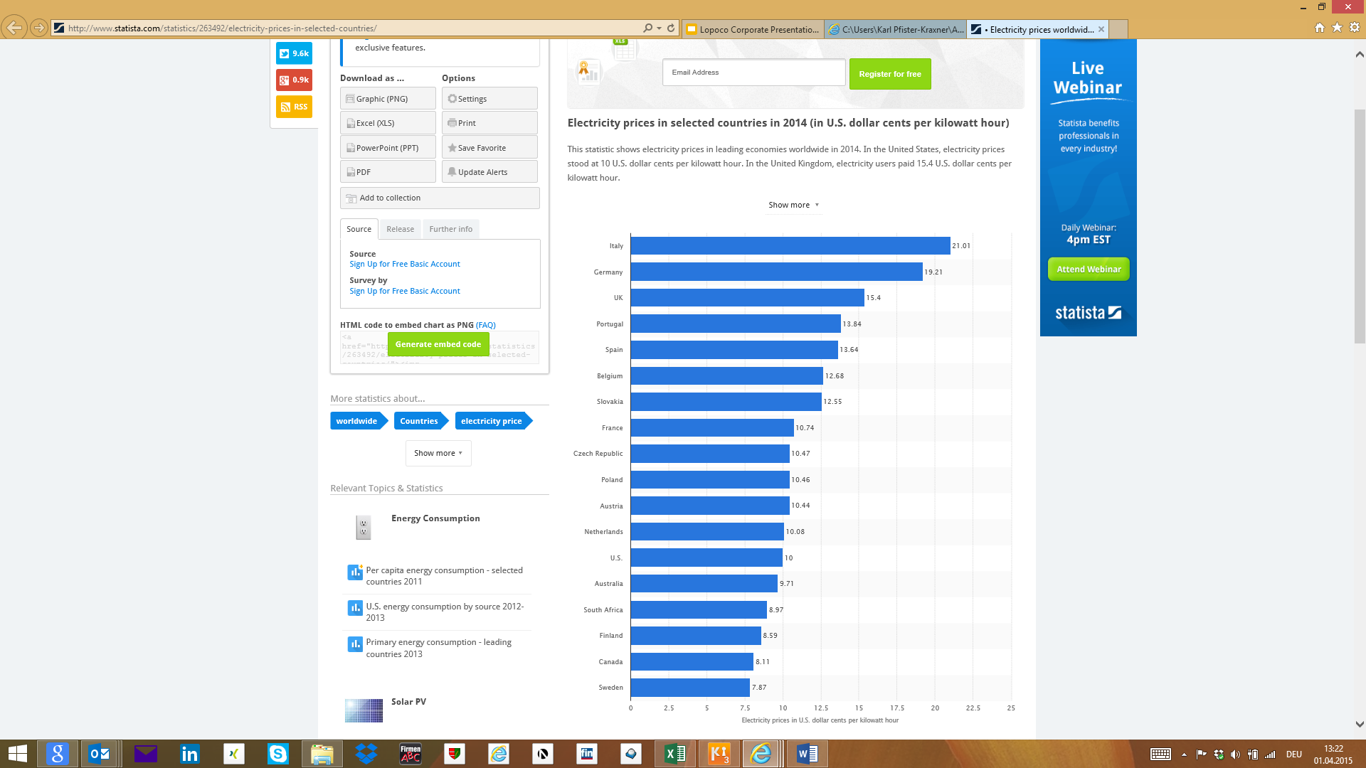
Current challenges in the industry
Private and public cloud adoption on the rise
SME´s using Cloud service providers
Competitive market for Cloud service providers
What they have in common is the challenge of
power consumption/operating costs
total cost of ownership
The cost for electricity is substantial and offers a great opportunity to lower OPEX!
Source:
Sign Up for Free Basic Account
© Statista 2015

Slide 5
Introducing Lopoco Servers & Storage to the Global Market
The cost of energy isn’t the only source of budget pressure.
Lower maintenance, less heat production, less vibration, higher uptimes, greater densities: these are just some of the advantages of Lopoco products, which are designed for ultimate efficiency and reliability.
Less heat means lower environmental impact, delivering on the promise of green computing products for both the enterprise and the data center.

Slide 6
Lopoco´s Contribution
for up to 75% energy savings
Proprietary, ground-up design specifically for efficiency
Painstaking component engineering
Fanatical adherence to efficiency mandate
Strong corporate persistence of vision
No sacred cows in server design principles
In excess of 2.5 man-years of design, research and development

Slide 7
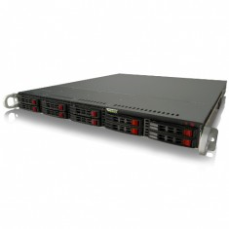
Product Positioning - Applications
SMB
Email serving
Mysql/Postgresql/Database
Apache/Web server
Web applications
File serving/NAS
DNS, DHCP, Firewall, Routing
Virtual elimination of special IT HVAC requirements
Quiet servers deployable in office areas
Reduction in IT hardare failures
Enterprise
Exchange
Database/Oracle
Apache/nginx Web Server
Tomcat/Web Frameworks
Commodity Storage
MS Active Directory/LDAP
DNS, DHCP, Firewall
Dramatic power reduction in IT & HVAC
Large decrease in IT maintenance & repairs
Higher Service availability
Decreased Service Latencies
Hyperscale
Hadoop/Redis/Mesos
OpenStack
NOSQL/Large Scale Database
Large Scale Distributed Storage
Zookeeper
Web serving hierarchy
Big Data Analytics
OpEx & CapEx reductions in $10mm increments
Lower staff requirements
Greater throughput per sq. ft.

Slide 8
Technology & Product Roadmap
2017
Series B
Product Line
2016
Series A
Product Line
1U Servers
2U Servers / Dual PS
Blade Servers
Entry level storage
Mid level storage
High level storage
Cloud Services
Advanced Cloud Services
Today
Lopoco
Milestone Product Line
1U Servers
2U Servers / Dual PS
Entry level storage
Mid level storage
Cloud Services
1U Servers
Entry level storage

Slide 9
Commercial Roadmap

Slide 10
Product/Solution Range
- Our Products
- backup some datasheets for each product
- future product roadmap
´need some more indivdual
product details as well

Slide 11
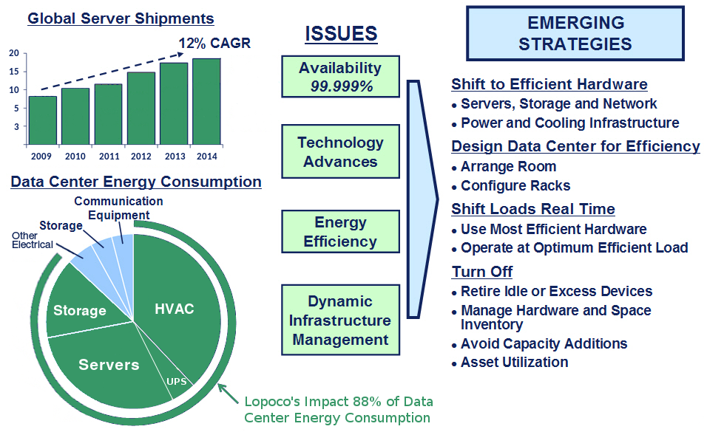
Blah de blah de blah
Oh, blah-blah de blah
And, blah-blah de blah-de-blah-blah-blah

Slide 12
Proven Technology
Ultra-efficient Servers & Storage
provide substantial energy and cost savings without sacrificing performance
built on proven, shipping technology without costly custom chips or strange form factors
deliver on the green computing ideal, allowing companies to significantly lower their environmental footprint
no risk: standard X86 processors, memory configurations and I/O connectivity
designed for modern applications: database; email; web; NAS; hadoop
broad installed base with uptimes exceeding 24 months

Slide 13
Product Solution Range
Ultra-efficient Servers & Storage
provide substantial energy and cost savings without sacrificing performance - see our white paper
built on proven, shipping technology without costly custom chips or strange form factors
deliver on the green computing ideal, allowing companies to significantly lower their environmental footprint
no risk: standard X86 processors, memory configurations and I/O connectivity
designed for modern applications: database; email; web; NAS; hadoop
broad installed base with uptimes exceeding 24 months

Slide 14
Ultra-efficient servers
an enormous unexploited opportunity
data centers (openstack, hadoop, spark, nosql)
web applications (apache, nginx, IIS)
enterprise applications (email, database, CRM, web frameworks)
virtualization: server consolidation combined with efficient hardware
cloud implementations (VMware, openstack, big data)

Slide 15
What customers are saying
We use Lopoco servers for almost all our IT needs. The fanless LP-2180 is our firewall, router, DNS and DHCP server all in one. We have a cluster of LP-4255’s for developers, virtual machines, and testing infrastructure. Some of the developers are amazed to find out that all of our Lopoco servers fit in one low-cost rack at our colo with a power budget of only 1.6 kWatts. And we could probably add another 10 servers without bumping up against the limit. Needless to say, we are very pleased. Lopoco even made us a short run of custom servers which we use to demonstrate our software to customers all over the world. - Simon Butler, Methodics Inc.
We got a pair of replicating postgresql database servers from Lopoco to handle all our most critical corporate and engineering data. The servers have performed admirably, and are all but silent and the air coming out the back is only 1-2 degrees above ambient. No special HVAC needed! The operating cost savings over a single big conventional server with dual-redundant power supplies and extra disks comes to roughly $500/year. We’re pleased with the performance, the environmental savings, and the money we save. - Dan Emerson, Light and Motion Industries

