Slide 1
Ultra-efficient, Green-tech Servers
sales@lopoco.com

Slide 2
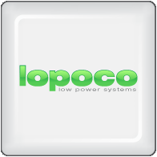
Our Vision
Designing, manufacturing and to bring to market ultra-efficient, green tech servers that provide substantial energy and cost savings without sacrificing performance by using proven, shipping technology without costly custom chips or disruptive form factors.
We aim to substantially decrease the TCO for corporates servers by creating value add server products generating lower heat, less vibration, higher density, lower investment required and substantially lower energy consumption (as much as 75% less).

Slide 3
About Us
Established mid-2010 by a group of Silicon Valley veterans in fields of server, storage, software and CPU design
Delivered first server to customer Q4 2011
Headquatered in the heart of Silicon Valley, California. European legal entity in process to be set-up in Austria, Europe.
Led by founder Andrew Sharp as CEO, a Silicon Valley veteran who joined Convergent Technologies in 1985, and has worked for Sun, SGI, HP and LSI, along with several startups.
Peter Theunis, CTO and co-founder, has more than 10 years of experience in large scale systems architecture at startups and at Yahoo!
Jack Mills, VP Engineering, while at Intel was an architect of the Pentium and the Itanium processors; later Director of advanced processor research; also an alumnus of Convergent Technologies [advisor]
Mark Brine, CFO, is a veteran of Silicon Valley startups, starting at VLSI, later VP of Finance at semiconductor startup Discera; now Director of Finance at Cloudera [advisor/board].
Karl Pfister-Kraxner EMEA is developing & driving the commercials for our EMEA entity. Karl has got +20 years of experience in senior management, sales, marketing, business development and organization management incl. P&L at leading global companies such as Samsung, Nokia, Hewlett-Packard, Sony and Microsoft.

Slide 4
Current challenges in the industry
Corporates are outsourcing
SME´s using Cloudservice providers
Even Corporates & SMEs operating their own servers
Competeitive market for Cloud service providers
What they have in common is the challenge of
power consumption/operating costs
total cost of ownership
The cost for electricity are still substantial and offer a great opportunity to lower OPEX!
Source:
Sign Up for Free Basic Account
© Statista 2015

Slide 5
Introducing Lopoco Servers & Storage to the Global Market
The cost of energy isn’t just the drain on your budget.
Lower maintenance, less heat production, less vibration, higher uptimes, greater densities: these are just some of the advantages of Lopoco products, which are designed for ultimate efficiency and reliability.
Less heat means lower environmental impact, delivering on the promise of green computing products for both the enterprise and the data center.

Slide 6
Lopoco´s Contribution for up to 75% energy savings
Painstaking component engineering
Sometimes overlooked or dismissed as tinkering, component engineering is one of the pillars of our efficiency story. And while it’s a never ending task, to be truly able to make products as efficient as ours, more than 1000 man-hours of component engineering and selection went into our first designs. Far from tinkering with a few well known parts, we’ve scoured the global component marketplace for the most efficient, reliable and low power consumption components, and we’ve done the R&D to package and utilize them, resulting in ultra-efficient, highly reliable systems. All while keeping a close eye on providing the requisite performance needed by server applications.
We start by selecting only CPUs and other IC components that are efficient enough to meet our standards, but provide excellent performance. Then we tightly design a server around them with countless hours of R&D to home in on maximum power consumption reductions. Shaving ¼ watt off a design or a component is a win for our R&D team. At the end, all of the little savings in a wide variety of areas interlock and add up to power consumption reductions that make our products stand out from the conventional manufacturers in a big way.
Needs bullet points here

Slide 7
Product Positioning - Applications
SMB
Email serving
Mysql/Postgresql/Database
Apache/Web server
Web applications
File serving/NAS
DNS, DHCP, Firewall, Routing
Virtual elimination of special IT HVAC requirements
Quiet servers deployable in office areas
Reduction in IT hardare failures
Enterprise
Exchange
Database/Oracle
Apache/nginx Web Server
Tomcat/Web Frameworks
Commodity Storage
MS Active Directory/LDAP
DNS, DHCP, Firewall
Dramatic power reduction in IT & HVAC
Large decrease in IT maintenance & repairs
Higher Service availability
Decreased Service Latencies
Hyperscale
Hadoop/Redis/Mesos
OpenStack
NOSQL/Large Scale Database
Large Scale Distributed Storage
Zookeeper
Web serving hierarchy
Big Data Analytics
OpEx & CapEx reductions in $10mm increments
Lower staff requirements
Greater throughput per sq. ft.

Slide 8
Technology & Product Roadmap

Slide 9
Commercial Roadmap

Slide 10
Product/Solution Range
- Our Products
- backup some datasheets for each product
- future product roadmap
´need some more indivdual
product details as well

Slide 11
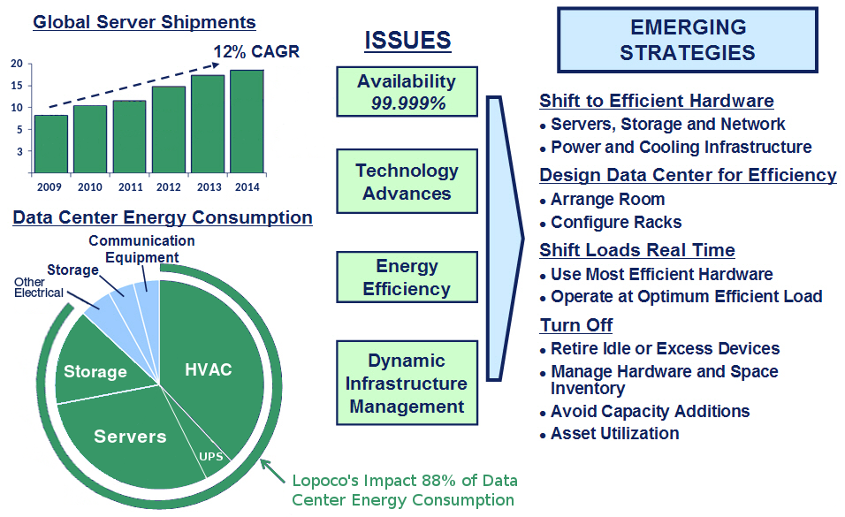
Blah de blah de blah
Oh, blah-blah de blah
And, blah-blah de blah-de-blah-blah-blah

Slide 12
Proven Technology
Ultra-efficient Servers & Storage
provide substantial energy and cost savings without sacrificing performance
built on proven, shipping technology without costly custom chips or strange form factors
deliver on the green computing ideal, allowing companies to significantly lower their environmental footprint
no risk: standard X86 processors, memory configurations and I/O connectivity
designed for modern applications: database; email; web; NAS; hadoop
broad installed base with uptimes exceeding 24 months

Slide 13
Product Solution Range
Ultra-efficient Servers & Storage
provide substantial energy and cost savings without sacrificing performance - see our white paper
built on proven, shipping technology without costly custom chips or strange form factors
deliver on the green computing ideal, allowing companies to significantly lower their environmental footprint
no risk: standard X86 processors, memory configurations and I/O connectivity
designed for modern applications: database; email; web; NAS; hadoop
broad installed base with uptimes exceeding 24 months

Slide 14
Ultra-efficient servers
an enormous unexploited opportunity
data centers (openstack, hadoop, spark, nosql)
web applications (apache, nginx, IIS)
enterprise applications (email, database, CRM, web frameworks)
virtualization: server consolidation combined with efficient hardware
cloud implementations (VMware, openstack, big data)

Slide 15
What customers are saying
We use Lopoco servers for almost all our IT needs. The fanless LP-2180 is our firewall, router, DNS and DHCP server all in one. We have a cluster of LP-4255’s for developers, virtual machines, and testing infrastructure. Some of the developers are amazed to find out that all of our Lopoco servers fit in one low-cost rack at our colo with a power budget of only 1.6 kWatts. And we could probably add another 10 servers without bumping up against the limit. Needless to say, we are very pleased. Lopoco even made us a short run of custom servers which we use to demonstrate our software to customers all over the world. - Simon Butler, Methodics Inc.
We got a pair of replicating postgresql database servers from Lopoco to handle all our most critical corporate and engineering data. The servers have performed admirably, and are all but silent and the air coming out the back is only 1-2 degrees above ambient. No special HVAC needed! The operating cost savings over a single big conventional server with dual-redundant power supplies and extra disks comes to roughly $500/year. We’re pleased with the performance, the environmental savings, and the money we save. - Dan Emerson, Light and Motion Industries

