Slide 1
Pitch Book
For Andre Liem

Slide 2
Contents
This document is a summary of Andre Liem’s resume along with the resources that he has available to develop business well in Asia
This document is to provide high level details to support Andre’s ability to quickly develop business in Asia with low risks and high returns
This document provides proof-points on Andre’s ability to quicken a firm’s go-to-market strategy in North America and/or Asia so that an organization can capitalize on the current growth trend
Details for resources (contacts and leads) and letters of recommendation are available upon request

Slide 3
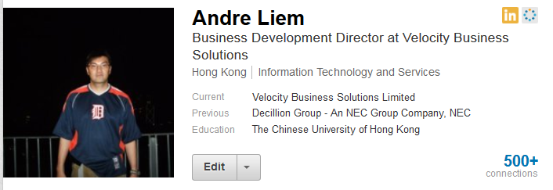
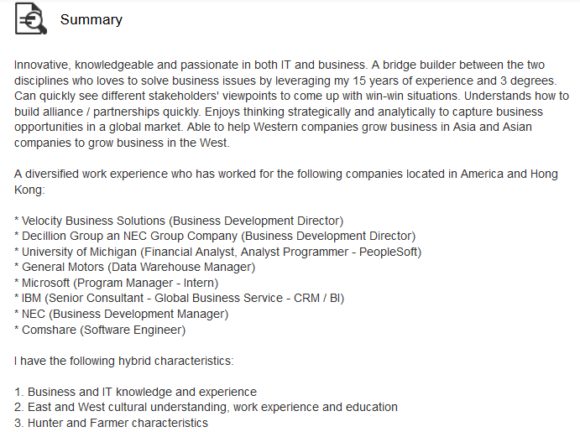
6 years of business development experience mainly in Asia
6 years of technical IT experience primarily on Business Intelligence / Big Data
5 years of financial analysis / process experience primarily in healthcare
Born in Indonesia, naturalized American, lived in Hong Kong for 8.5 years
Make an excellent bridge builder in so many ways

Slide 4
Business Development Responsibilities
Sale Manager – Managed sales teams. Not shy in doing cold-calling. Worked closely with Marketing teams to plan and setup marketing events that help drive leads. Provided the account planning and execution. Have a strong database of senior and executive level contacts. Have closed deals that are worth millions of dollars.
Bid Manager – An SOA-QPS2 Deputy Program Manager (www.ogcio.gov.hk/en/business/business_window/soa_qps.htm). Managed the entire bidding process for these tenders which consist of: understanding the true purpose of the tender, source the right solution based on capability and price, write technical proposal which can be over 150 pages, negotiate pricing and managed all stakeholders expectations.
Solution Developer – Able to quickly understand the technical specifications and business value for a variety of solutions. Have sold Knowledge Management, Workflow Management, Business Intelligence, Data Visualization, SWIFT, Compliance, Cash Management and bespoke development. Acted as a technical pre-sales consultant providing the demos and discussing the technical aspects of the solution offered.
P&L Manager – Provided the business strategy and leadership to move the organization forward. Managed the team’s budget projects’ P&L. The budgeted numbers are in the millions of dollars.
Partner Manager – Worked for a few System Integrators where we acted as a “grocery store” for IT solutions. This is enabled through the development of a partner network. Worked with large multinational org to large regional organizations to small niche companies to Indian companies and to Mainland Chinese companies.

Slide 5
Resources
Contacts
100,000+ contacts in North America to complement business initiatives at home
40,000+ contacts in Asia → Almost unlimited number of ways to segment
6,000+ contacts in Hong Kong → A major market to quick test strategies in cost effective manner
3,800+ contacts on social media→ Several years of experience in aggressively networking. Over 2,500 contacts on LinkedIn alone
1,000s of executives, senior managers and front line workers in both business & IT
Leads
Currently, 25 leads with many potential Asia wide
Leads range from large local Hong Kong business to large multinational companies
Many contacts within each lead to do account planning well
Over 75 InMails on LinkedIn for better way to qualify leads

Slide 6
Letters of Recommendation and Endorsements
Over 20 letters and endorsements
From America and Hong Kong
From academia to multinational companies to local businesses
From executives to professors to line managers
Companies Providing Letters

Slide 7
Please Let Me Know If You Would Like More Details
THANK YOU!

