Slide 1
ESG Freeware
Addition of ESG Freeware Tools to LSI Web Site
10/15/09

Slide 2
Background
Objectives
Provide end users with tool sets to support ESG Products.
For example:
Sample Command Line Interface (CLI) scripts
Freestanding utilities
Leverage and encourage the ad-hoc development of Scripts and Utilities
Created to address specific issue
May be done by SE, Support Team, Development, others
Provide recognition for the developers
Boundaries
Distributed as Freeware
Released “AS IS” with no guarantee of function or support
LSI Legal has provided EULA with these limitations
Not tested through the ESG Product Test group
Not required to meet ESG “Look and Feel” or Usability standards
Limited OS support
Users must register at LSI download site for access
App-Aware and Tools team reviews user registration

Slide 3
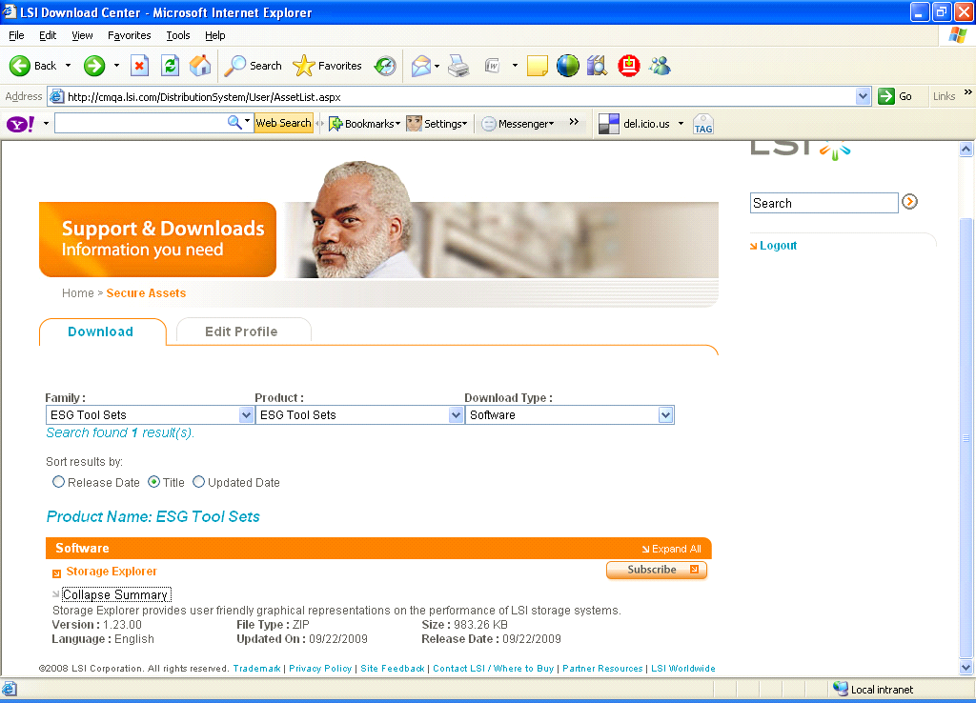
Implementation – User Download
User registers at LSI Download site
Basic demographic information captured
App-Aware and Tools approves user
Verification sent to user
User can log in to ESG Tool Sets
Storage Explorer is the first offering

Slide 4
Implementation – Submissions
Recognition Program created for potential additions to Tool Sets
Utilize existing recognition program for financial incentive
Expedited Management Review
Ensure consistency with ESG direction
Avoid duplication of existing capability
Set financial incentive level
Notify submitter of acceptance and financial incentive level
Creator needs to submit the following items for release
Outline of test methodology
Peer review (e.g., at Experience Centers)
Open Source components used
“Read Me” file describing operation
Release steps
App-Aware & Tools makes available on ESG Freeware site
Creator receives financial recognition

Slide 5


